Slide 1

What’s in a Model?
The inner workings of LLMs
Matthew Charters (he/him)
CEO, CharityCAN
2024 Apra Canada Virtual Conference
October 23, 2024

Slide 2

Generative AI
An algorithm that can produce content, like…
Text
ChatGPT (Open AI, powered by GPT-3/GPT-4) – 2022/2023
Bard (Google, powered by PaLM 2) - 2023
Meta AI (Meta, powered by Llama 2) - 2023
Images
DALL·E/ChatGPT (Open AI, powered by DALL·E 3) - 2021
Stable Diffusion (Stability AI) - 2022
Notes:
This talk will focus on what has emerged – really the last few years – on what has been termed “Generative AI”
Algorithms that produce content, text and images like the one here
Some of us might be wondering how these advancements are going to be used, specifically in prospect research.
I want to go backwards and take a look at where these models came from
Knowing a bit more about how these models work can help you figure out what they’re good at and where to apply them

Slide 3

Large Language Models
Models like GPT, PaLM, Llama, etc.
Power apps like ChatGPT, Claude, Bard
Trained on billions of inputs
Produce text by predicting the next word
Notes:
We’ll work towards understanding more about LLMs
I’m guessing that the AI model that most of us here have interacted with is large language models – ChatGPT, etc.
Quick show of hands for who has used no AI – chat GPT – image generating functions
Here’s what most of us probably know
But what does that training actually mean? How does the prediction work?
Due to how these models are created, we don’t have all the answers
But we can at least examine
Neural networks and deep learning
The algorithm that powers these LLMs
The inputs
How they learn

Slide 4

About Me
BMath in Computer Science, University of Waterloo ’05
Run CharityCAN, prospect research software for Canadian fundraisers
Been using and programming with deep learning and language models for a year or two now – so still new to the field!
Notes:
I come from a background in Computer Science
Now I run CharityCAN, which many of you are familiar with – if you’re not, you can come check out our sponsor session later today
Deep learning wasn’t around in 2005, and I’m not and AI researcher
but I’m lucky enough to have been able to research use and code with some of the models I’ll be talking about today
I hope I can pass some of that understanding along

Slide 5
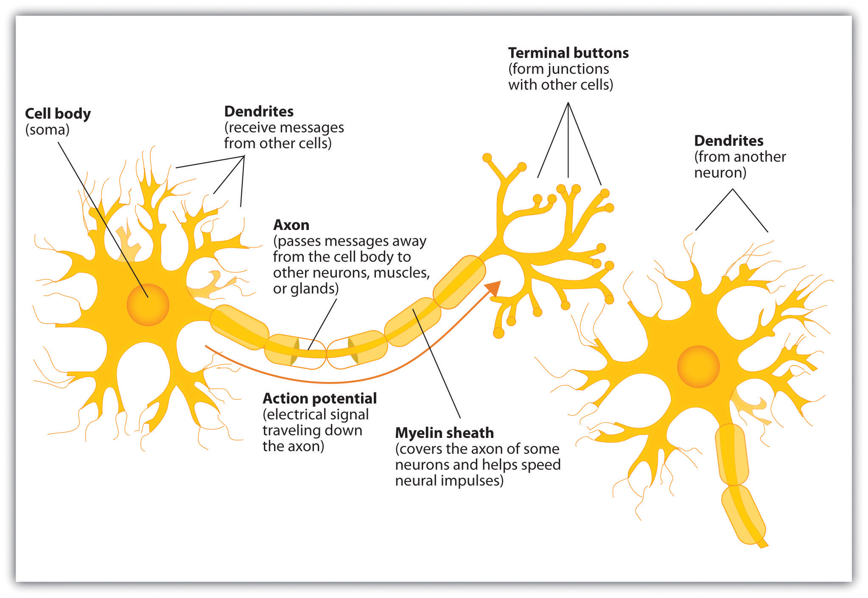
Artificial Neural Networks
A Logical Calculus of the Ideas Immanent in Nervous Activity
Warren S. McCulloch and Walter Pitts, 1943
First representations were non-learning
Notes:
What do we mean when we say “neural network”?
The concept for artificial neural networks has been around since the 1940s
Researchers decided to look at the brain and create a mathematical model of how the brain worked – no learning, just modelling
In the brain, neurons are connected by synapses – trillions of connections
Electrical impulses add up in the neuron until they “fire” and send a signal to other connected neurons
Over time pathways that are used more get stronger and others fall away (neuroplasticity)

Slide 6
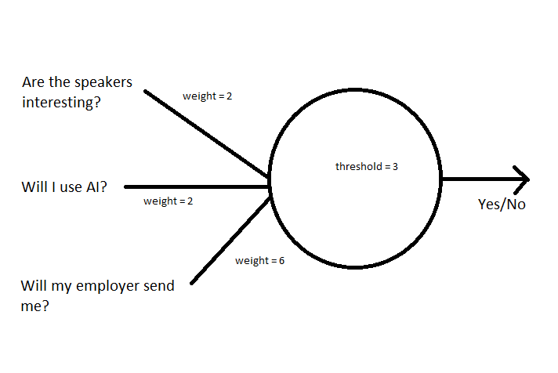
Perceptrons
Should I attend the Apra Canada Virtual Conference?
The Perceptron: A Perceiving and Recognizing Automaton
Frank Rosenblatt, 1957
Designed for binary classification tasks
Limited by the problems it could solve (Marvin Minsky and Seymour Papert, 1960)
Limitations led to decreased interest
Notes:
A perceptron is the simplest neural network:
Takes one or more input values
Each input is given a certain weight
A constant bias term is added to the weighted sum of inputs
The value is passed through an activation function which outputs the final value
In this example, we decide whether or not we will attend a this conference
Inputs are the three yes/no values on the left, 0 or 1
We assign weights to the inputs – here whether or not my employer will pay for my ticket will override the other two but if I’m going to be using AI and the speakers are interesting, then I’ll go
The yes/no is activated if we pass the threshold or bias
Now the perceptron was a bit limited in the kinds of questions it could answer, so research died down

Slide 7
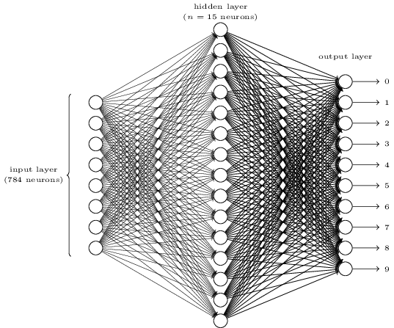
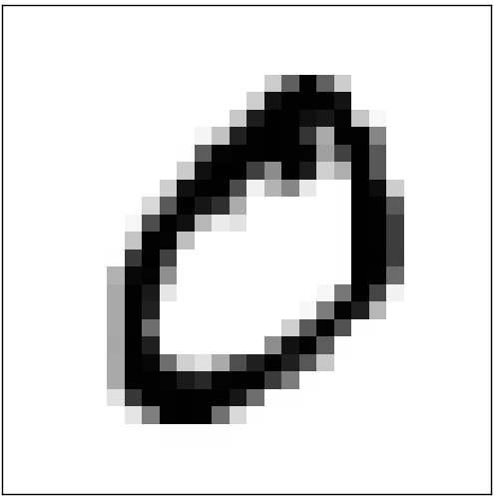
Multilayer networks
From the 60s to the 80s, research moved slowly, but
Linking perceptrons in layers overcame their limitations
These networks could be “trained” by something called “stochastic gradient descent”
Research culminated with a paper on backpropagation, which renewed interest in neural networks (1986)
=> 0
Notes:
It was found that by taking the inputs from one set of perceptrons and sending them to another set with a non-linear activation function (another bit of math), you could model any bit of math you can imagine
These multilayer networks can learn their weights (what should I take in) and biases (what should I put out) by looking at labelled examples and doing some calculations
This learning can happen very efficiently
So what does this look like? Here’s an example of a neural network to recognize handwritten numbers:
Given an image of 784 pixels (28 x 28 square) representing a handwritten number,
What we want is that pixels that turn on for certain numbers and not others in the hidden layer should activate the corresponding neuron in the output layer for the correct digit.
Here we have 784 x 15 = 11,760 weight parameters in the hidden layer and 15 x 10 = 150 weight parameters in the output layer. We also have 25 bias variables, 1 for each neuron.

Slide 8
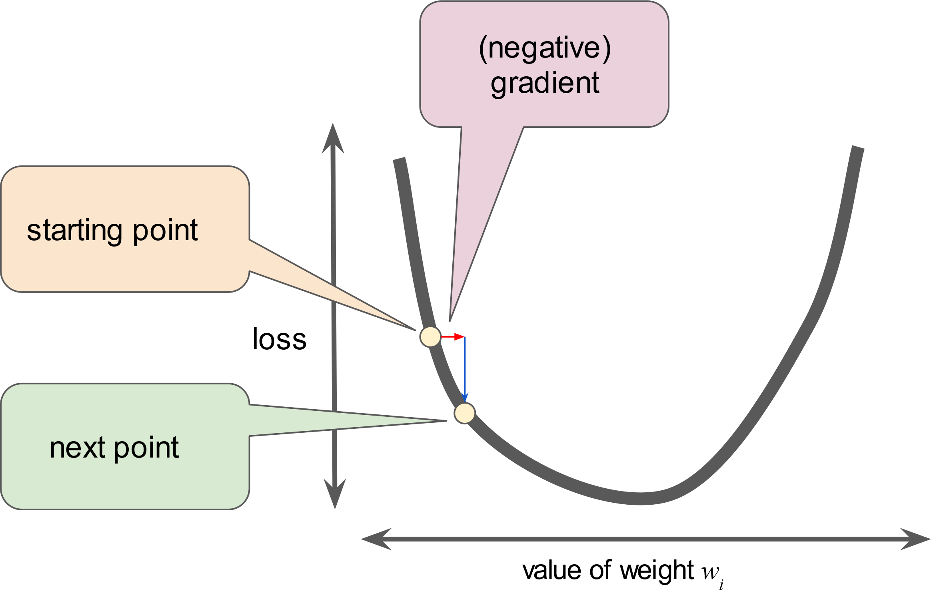
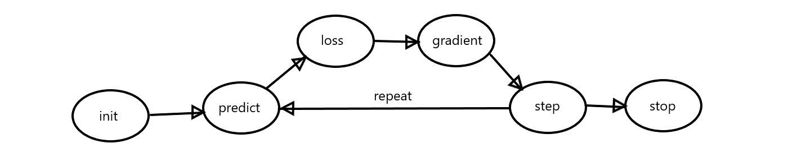
Training
The only slide that mentions calculus, I promise
Notes:
How do we train our handwriting example?
Gather some “training data” – labelled images of numbers in this case
Initialize our weights and biases to random numbers
Take some training example, say the zero in the last slide, and try to predict the outcome
Since the weights and biases will be random, the prediction will be terrible
Can we quantify how terrible the guess is? Yes! We calculate a loss function – how far off from the correct answer are we?
The next step is the “gradient descent” part – we are trying to minimize the loss function
We calculate the gradient using calculus (I’ll gloss over this part) but calculus will tell us whether we should INCREASE or DECREASE the weight we’re examining to get closer to the “right” value for the weight – the value that minimizes loss.
We move a predetermined amount in that direction, and then try our predictions again
We do this again and again until we decide to stop (also predetermined)
We’re doing this for every one of the 12K weights and 150 biases in our handwriting example
Thanks to a nice bit of math (matrix multiplications) we can do it all at once, which makes this go fast

Slide 9
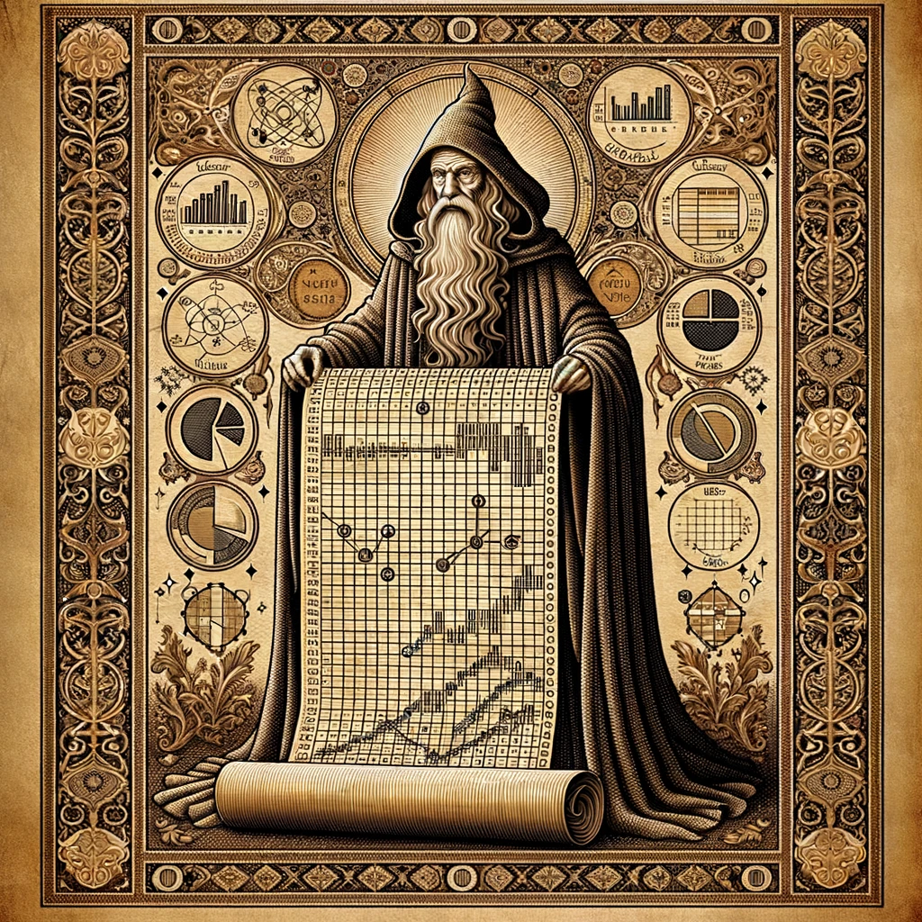
Full Example Using State of the Art Computing Software
j/k let’s use Excel
Notes:
The idea to use excel is not mine, credit goes to Jeremy Howard of Fast.AI, who has a course I will link to
The excel spreadsheet is a neural network that tries to predict survivors of the Titanic, which has become a standard learning tool for machine learning datasets
This is an even smaller network than our handwriting example, with only two neurons in the hidden layer
We looked at representing an image with pixels – computers need these kinds of representations
Let’s look at the input representations here for the titanic data

Slide 10
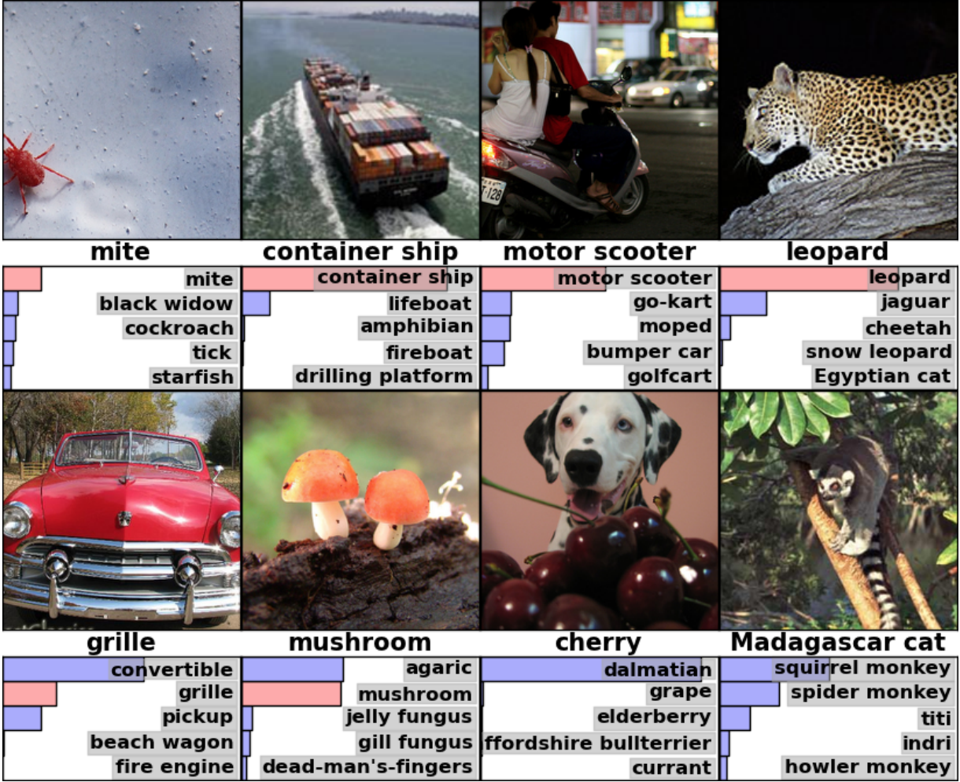
Deep Learning
ImageNet Classification with Deep Convolutional Neural Networks
Alex Krizhevsky, Ilya Sutskever, Geoffrey Hinton, UofT, 2012
8 layers
650K neurons
60 million parameters
15 million training images (vs. 60K in MNIST)
15% error rate (vs. previous best 26%)
Trained on GPUs
Notes:
Landmark paper in deep learning came from UofT in 2012
ImageNet competition where computer models had to try and correctly classify images like the ones above
You can see how good this algorithm was
Mite even though some of the bug is cut off – unlike the digit recognizer where numbers were in the middle every time
Even better than humans/labels
Dalmation
Agaric (type of mushroom) vs mushroom
What makes this different?
Number of layers
Size of training data
Training matrix math on graphics processors

Slide 11
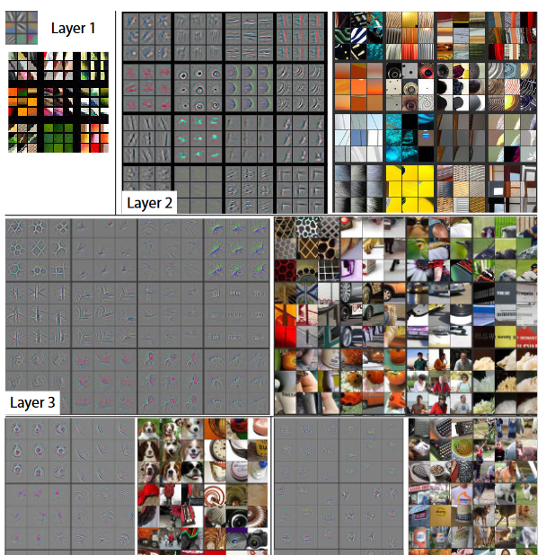
Representations within models
Different layers have different kinds of feature detectors
Each layer recognizes more complex features than the previous layer
Each layer also “looks at” more of the picture than the previous layer
Notes:
Researchers created a 5 layer image recognition model that could show them the patterns it was recognizing
So it’s after 2012 that deep learning really takes off and we see lots of different applications from a combination of lots of data and lots of layers
Voice recognition like Siri, Alexa
Image detection
Text to speech
Language models
Translation
Sentiment analysis
And finally… large language models!

Slide 12

Modelling language
We need a way to represent text in neural networks
Notes:
We saw that we can translate tabular data into ones and zeros, or numbers
Or images into pixels and then into numbers
But we haven’t yet looked at how models represent words, which is a different kind of problem

Slide 13

Distributional hypothesis
We can understand new words from contexts we recognize
With that I scuttled down the companion with all the noise I could, slipped off my shoes, ran quietly along the sparred gallery, mounted the forecastle ladder, and popped my head out of the fore companion.
-- Treasure Island
Notes:
How do humans learn words? An adult has a vocabulary of 30K – 100K or 7-10 words a day
Word context matters a lot – the theory of the distributional hypothesis is that context is how humans learn
Reading Treasure Island I have no idea what the parts of a sailing ship are called but I can still figure out what’s happening in this passage
The words *around* a word matter just as much as the word itself

Slide 14

Context and meaning
Senses
mouse (N)
1. any of numerous small rodents...
2. a hand-operated device that controls a cursor...
Word Similarity
Cat and dog
Word Relatedness
Coffee and cup
Notes:
Context can do a lot of things:
Distinguish between different word meanings
See words in enough contexts together and their meanings become similar
See words in enough contexts together and they become related
BTW this is my favourite AI image – note the table and chair legs getting mixed up including one that turns into a mouse cord, the dog’s… chair? The typewriter sink?

Slide 15
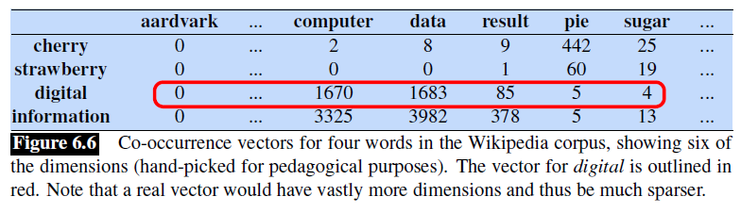
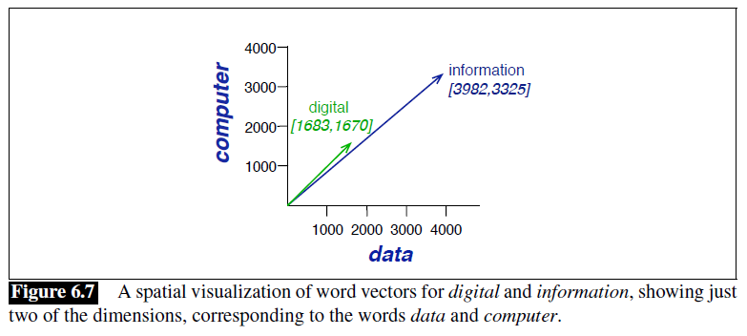
Vectors from words
Vectors are a list of numbers that define direction and length (or magnitude) – think of an arrow pointing north on a map for 5 km
Vectors can have many dimensions
We can examine the context around words to produce vector (numerical) representations of them
Notes:
Turns out if you look at the word AND the words around it (the context) you can create representations of words that contain the information in the last slide
In this example, we look at words in a Wikipedia article and the words around them, and count how many co-occurrences there are
In this case, the “directions” are the relationships between words and the “length” or magnitude are how often they occur together
Comparing the word vectors we can see similarities in the space

Slide 16
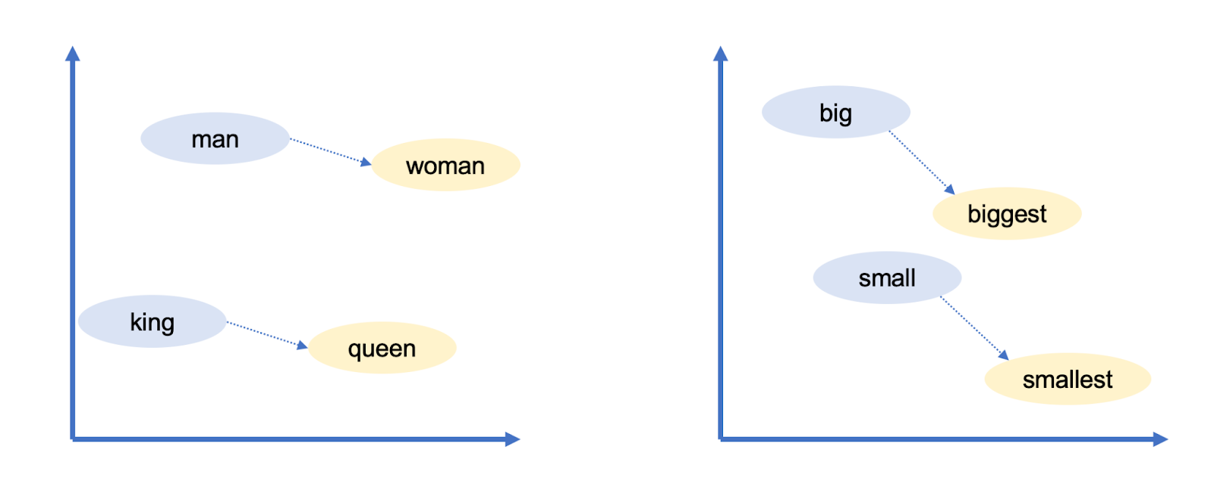
word2vec and semantic relationships
Efficient Estimation of Word Representations in Vector Space
Tomas Mikolov, Kai Chen, Greg Corrado, Jeffrey Dean, 2013
Used a very large data set (millions of documents from Google News)
The word vectors produced by word2vec could be added and subtracted to make deductions about words
Words with multiple meanings still only have one vector
Notes:
Google created a new way to create vectors out of words with word2vec
Training a model to predict whether two words are likely to appear together in text
The cool thing about these new vectors were that you could reason with them:
King – man + woman = queen
But along with the training data came some of our own implicit biases:
Doctor – man + woman = nurse

Slide 17
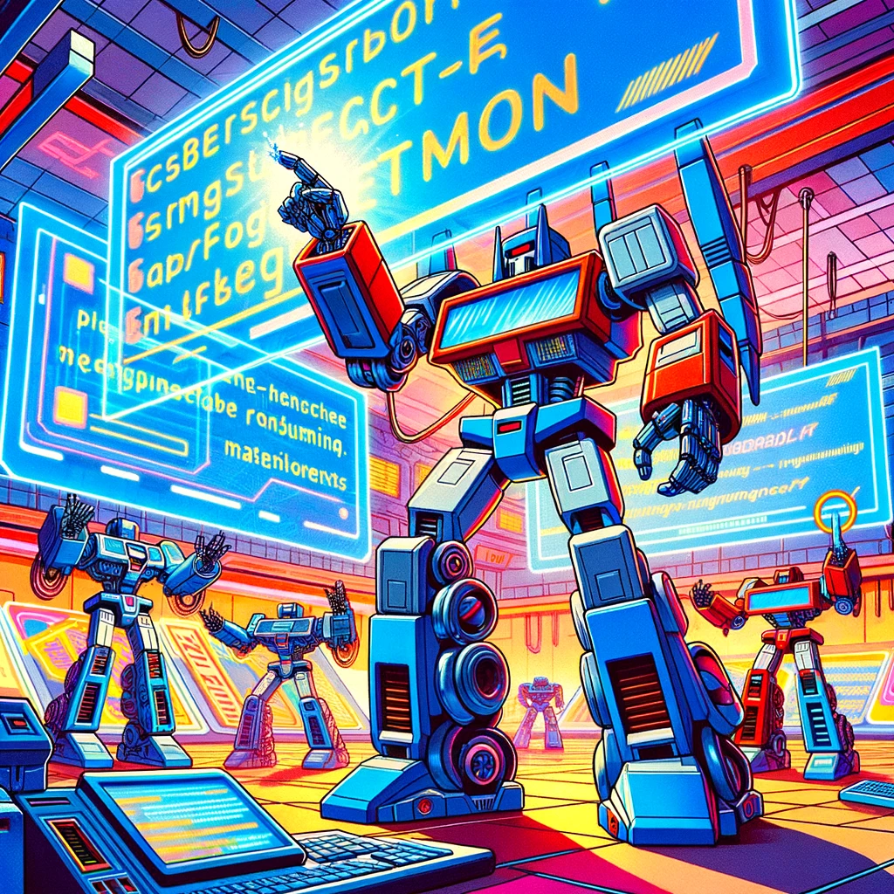
Transformers
Attention Is All You Need
Ashish Vaswani, Noam Shazeer, Niki Parmar, Jakob Uszkoreit, Llion Jones, Aidan N. Gomez, Lukasz Kaiser, Illia Polosukhin, 2017
Transformers are the building blocks of large language models
They take word (token) vectors and try to predict the next word
Notes:
As a child of the 80s I could not help but include an image of Transformers toys. ChatGPT swore up and down it couldn’t draw me a real Transformer because of “copyright concerns” but I dunno…

Slide 18
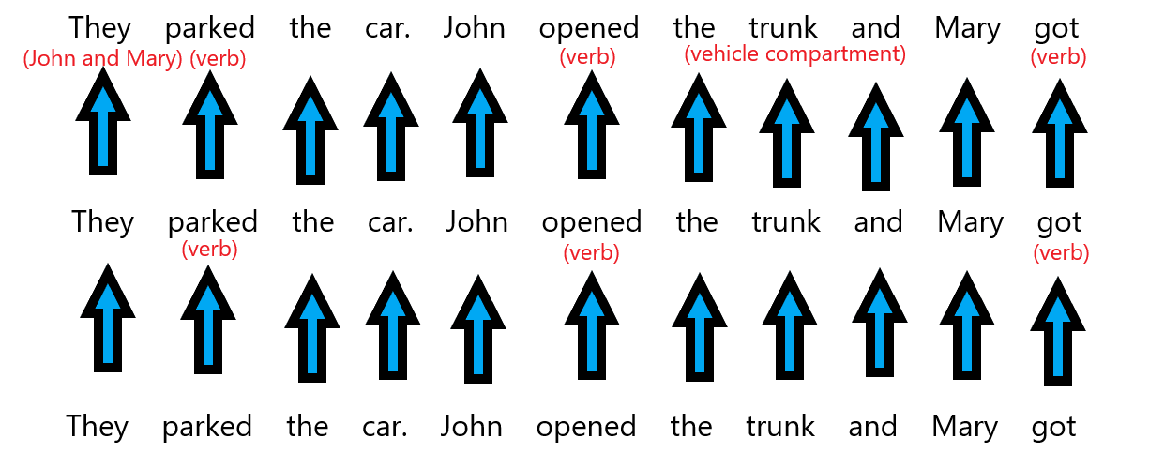
Model steps
Each transformer layer consists of two general steps:
Attention step
Feed-forward step
Notes:
This is a purely hypothetical language model – we’re at the point now where these algorithms are complex enough that they’re hard to diagram easily
But the general steps are the same – take some weights and biases, start with something random, predict some output, generate the loss, refine the weights, and repeat
Attention step:
Each word looks around for other words that match its own characteristics
E.g. “They” looks for two subjects, while “John” and “Mary” might each say “I am a subject”
The network finds this information and copies some info between the two words to link them
This happens several times in parallel (at once) at each layer, and each layer passes the information it finds onto the next layer after it
This information swapping happens at what are called “attention heads” which end up focusing on different lexical analysis tasks – matching pronouns and nouns, or linking words together
Feed-forward step
This step does pattern matching to predict the next word in the sentence, using all the information produced by the attention step
They can be thought of as encoding everything the model has learned from training data

Slide 19
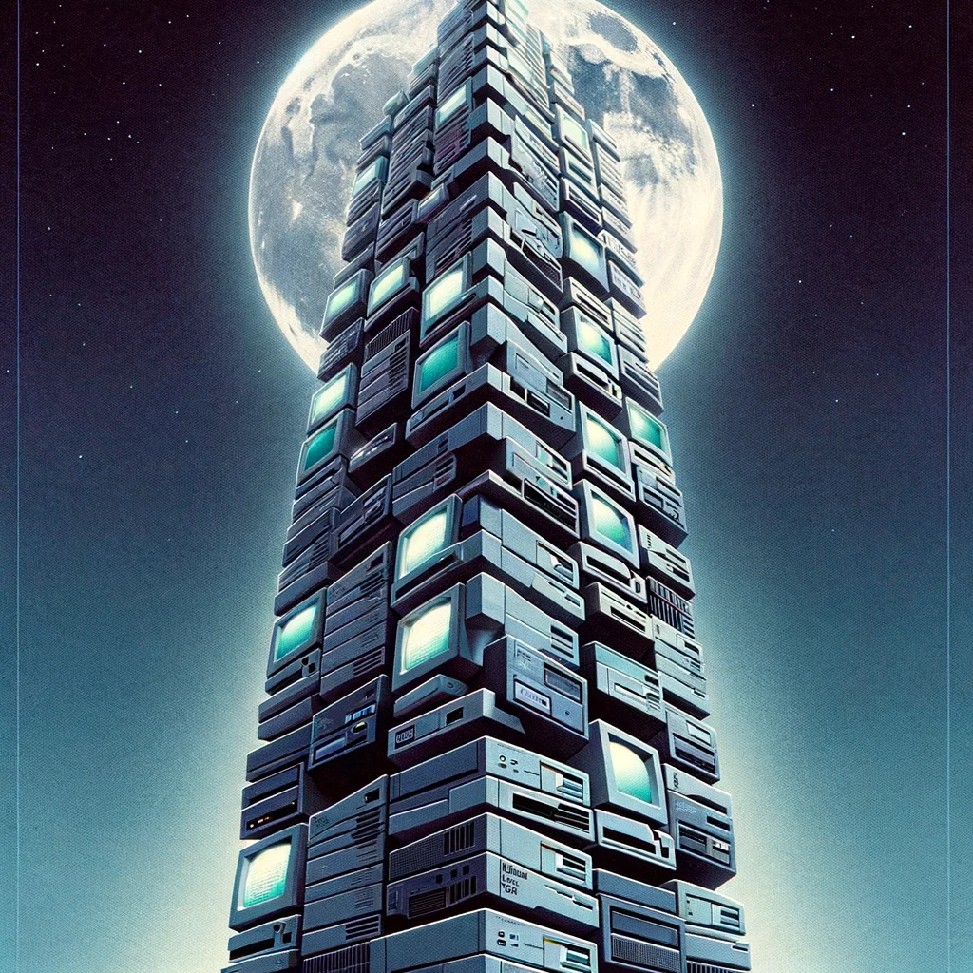
Models at scale
GPT-1 (2018)
768-dimensional word vectors
12 layers
117 million parameters
GPT-2 (2019)
1,600-dimensional word vectors
48 layers
1.5 billion parameters
GPT-3 (2020)
12,288-dimensional word vectors
96 layers
175 billion parameters
GPT-4 (2023)
1 trillion parameters?
Notes:
These models are so good at what they do because they are HUGE

Slide 20
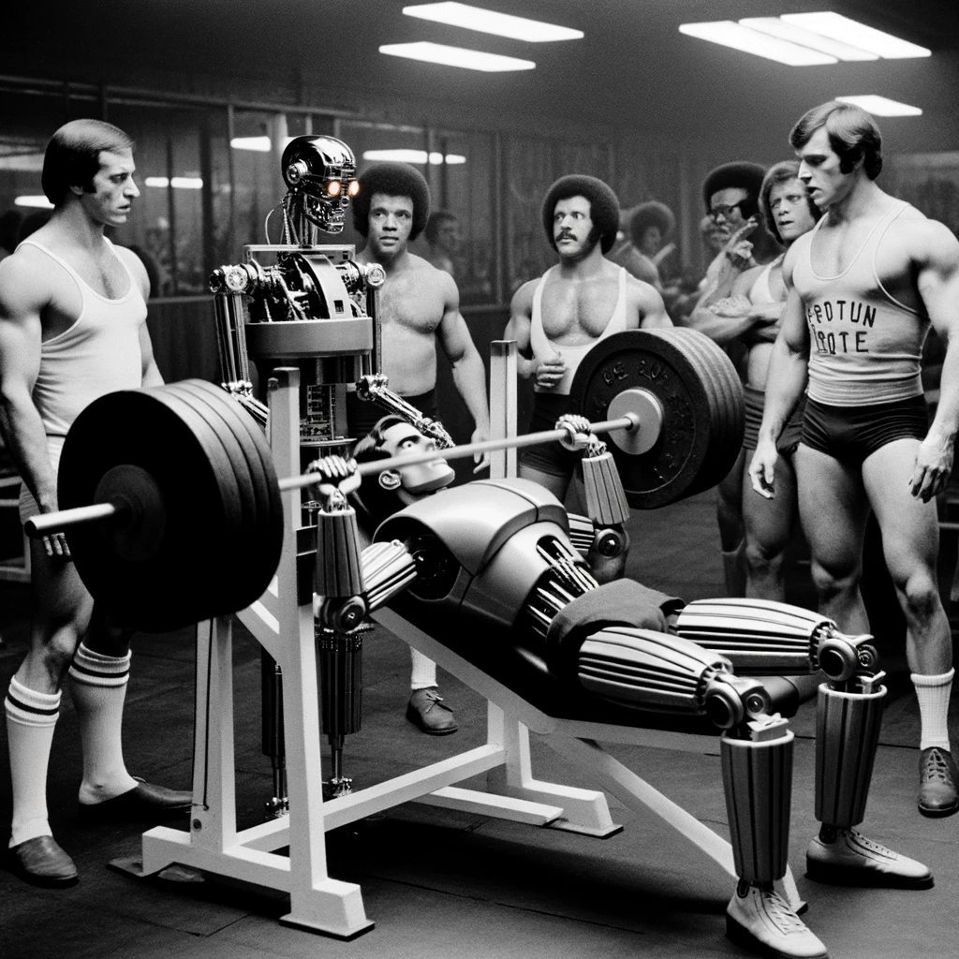
Training LLMs
Step 1: Pre-training
Feed the model the internet
Step 2: Fine-tuning
Get the model answering questions
Step 3: Reinforcement Learning from Human Feedback
Get the model talking to people
Notes:
So pre-training the model means making it learn all the word vectors and weights necessary to be able to accurately predict the next word
These models “read” text from the internet – from Wikipedia, blog posts, news articles, reddit, etc.
They don’t need labelled training data because they’re always just trying to predict what’s next in the current sentence
But predicting the next word might not always make a good chat bot
So the second step is using a dataset of questions and answers, so that the model gets better at answering questions
Then the third step (not always used) is getting people to interact and make the model better based on what people like or don’t like
Remember when ChatGPT launched for “free”? And we were asked what answers we liked and didn’t like?
But here we go, introducing our biases again
Humans like to hear confident answers
So the chatbot tries to be right, even when it’s wrong

Slide 21

Questions
But how do they work?
What are they good at? Why?
Are these models intelligent?
What can these models tell us about ourselves?
Notes:
How do they work?
Research continues
OpenAI’s GPT current models are “closed” – nobody can see the implementation details
These models are so big with so many connections it’s just so hard to see what’s going on
Researchers can and do use open source models to do research
Just starting to understand the jobs the various attention heads do and how sentences are parsed, how they are able to do some of the magic things they seem to be able to produce
So what are they good at?
Great at tasks like summarization, translation – anything that is “converting” word vectors
Good at “general” information retrieval (lossy compression) – or specific retrieval given additional data (prompting)
Are they good at reasoning? Maybe not so much? But getting better
Are they intelligent?
Open to debate!
Theory of mind
There is a bag marked “potatoes” on the table. The bag is full of apples. Joe has never seen this bag before, never looked inside it, and reads “potatoes”. He thinks the bag is full of…
The ability to reason about what someone else is thinking and feeling
Experts aren’t sure if there are other animals that can do this
Early LLMs were bad at this, but GPT3 and 4 are much better – does this mean they’re smart?
Or maybe it’s that to model language, which describes the world, we actually end up modelling the world – compressing it via word vectors down to a representation that we can query programmatically
What do models tell us about ourselves?
Bringing it back to biology and where these networks originated
What makes humans “intelligent”? This is up for debate too!
Some folks think that our brains are similar to these LLMs – just big, complicated prediction machines with an internal representation about the outside world that lets us predict what happens next
Predicting what happens next is very useful to stay alive – if I see a bear coming, I better get away

Slide 22

Questions?
Large language models, explained – Tim Lee and Sean Trott
How computers got shockingly good at recognizing images – Tim Lee
Neural Networks and Deep Learning – Michael Nielsen
Speech and Language Processing – Dan Jurafsky and James H. Martin
Practical Deep Learning – Jeremy Howard
A Hacker’s Guide to Language Models – Jeremy Howard

Slide 23

Thank you!
matthew@charitycan.ca
https://charitycan.ca/ai
https://www.linkedin.com/in/matthew-charters-a1894639/

