Slide 1
Board Member Pipelines
What’s the Deal with all this Tracking?
Amber Palmer, MA
Director, Research Analytics
Sinai Health Foundation

Slide 2
Agenda
Sinai Health and the Sinai Health Foundation
Governance Renewal
Sample Board Candidate Profile
Raiser’s Edge Volunteer Fields
Strategy Development and Maintenance
What’s Next

Slide 3











Sinai Health by the Numbers (2023-2024)
Sinai Health
Mount Sinai Hospital
6,703
104
Patient and
family advisors
Employees
425
14
Patient and Family Advisory Committees
Physicians
509
231,720
Minutes of interpreter services calls
Volunteers
Hennick Bridgepoint Hospital
123,219
Patient lives touched
(All services, inpatient, outpatient)
Mount Sinai Hospital
Hennick Bridgepoint Hospital
384
474
Lunenfeld-Tanenbaum Research Institute (LTRI)
Beds in service
Beds in service
1,415
583
Nurses
Nurses
55,103
3,080
Emergency visits
Inpatient admissions
6,888
14,823
Babies born
Outpatient visits
Circle of Care
(system partner)
28,184
11
Average number of disciplines per care team
Inpatient admissions

Slide 4
Sinai Health Foundation
Recently celebrated Mount Sinai Hospital’s centennial and held the Gala of the Century
$80.2M in raised revenue during our last fiscal year
Research Analytics is comprised of Data Strategy and Privacy, and Prospect Research and Management and sits under the Governance and Advancement Services team
We support portfolios across the foundation

Slide 5
Governance Renewal
Former Status
Manually tracked
No integration with Prospect Research
Current Status
Tracked in database
Prospect Research attends Nominating and Governance Committee
Ad-hoc Research requests
Prospect Research integration with the nomination process
No ability to report on the candidate pipeline
Creation of board candidate statuses

Slide 6
FY24 Board Pipeline

Slide 7
Board Candidate Status
Identified
Cancelled
N&G Review
Board Segmentation
Declined
Ask Made
Recommendation

Slide 8
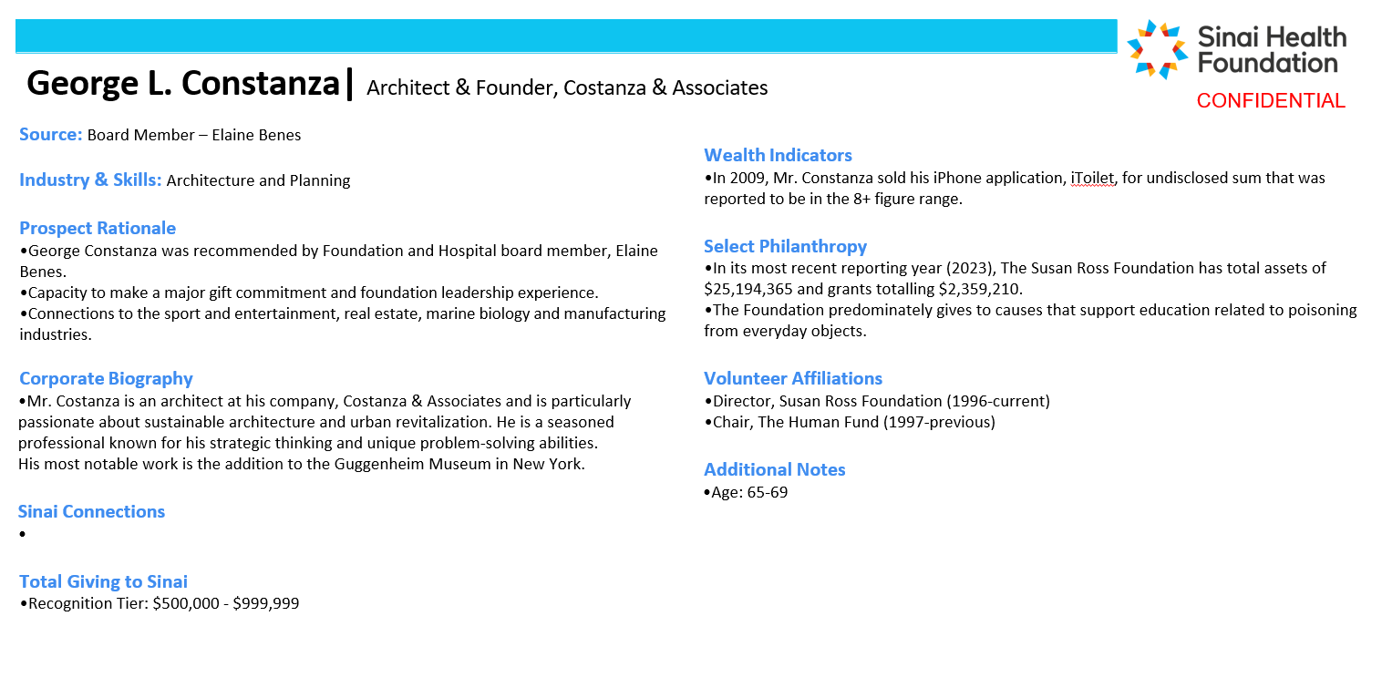
Revamp of Board Profile

Slide 9
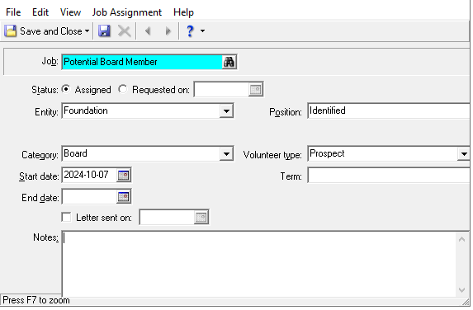
Raiser’s Edge – Volunteer Tab

Slide 10
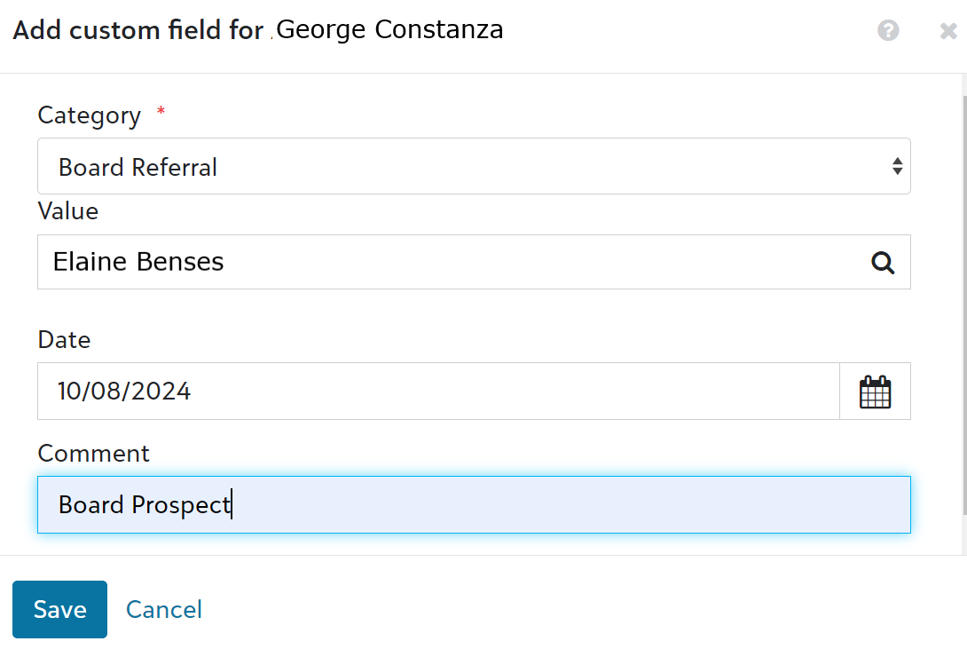
Raiser’s Edge – Attributes Tab
Track board candidate / prospect referrals from board members and other volunteers under constituent attributes in RE.

Slide 11
Strategy Maintenance & Development
Internal reviews and communication
Development of engagement inventory
Fundraiser assignment, as applicable

Slide 12
What’s Next…
Pipeline report development
Automation of board profiles
Expanded tracking related to candidate and board member skills and interests

Slide 13

Questions?

Slide 14

Amber Palmer
Director, Research Analytics
Sinai Health Foundation
amber.palmer@sinaihealthfoundation.ca

