Slide 1
Navigating the Hazards of Fantasy Fundraising
Adam Fox
Associate Director, Research & Analytics, Advancement Operations, Faculty of Applied Science & Engineering, University of Toronto

Slide 2
Learning Objectives
The presentation will offer actionable steps for moving from aspirational 'fantasy fundraising' to an evidence-based, data-driven approach. Participants will walk away with strategies to refine their prospect base and focus on realistic and sustainable fundraising goals
Recognizing and Avoiding the Pitfalls of 'Fantasy Fundraising': Participants will learn to identify signs of unrealistic expectations in major gift prospect portfolios, such as relying on improbable 'miracle donors,' and understand the risks involved, from missing short-term goals to negatively affecting organizational reputation
Data-Driven Decision-Making for Realistic Goal Setting: Attendees will be introduced to Total Addressable Market (TAM) in the context of major gift fundraising. They will learn how to quantify potential donor markets through surveys, data, and other evaluative tools, ensuring resources are focused on achievable targets
From Theory to Practice: Strategies for Maximizing ROI in Major Gift Fundraising: The presentation will offer actionable steps for moving from aspirational 'fantasy fundraising' to an evidence-based, data-driven approach. Participants will walk away with strategies to refine their prospect base and focus on realistic and sustainable fundraising goals

Slide 3
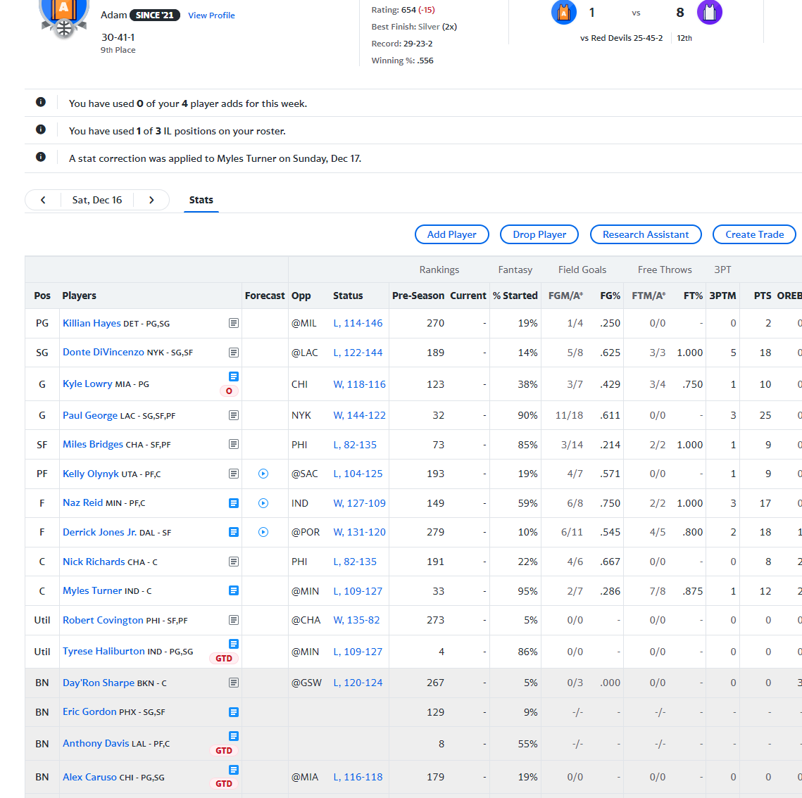
Introduction to Fantasy Fundraising
Concept Origin: Inspired by fantasy sports
Fundraising Parallel: Managing virtual teams vs. creating donor portfolios
Thrill of the Game: Excitement in speculation and predictions
Risk of Unrealism: The lure of improbable, high-profile donors
Impact on Fundraising: Consequences of chasing unrealistic goals

Slide 4
Fantasy Fundraising Defined
Fantasy vs. Reality: Idealistic aspirations in donor selection
Chasing the Whales: Pursuit of improbable high-profile donors
Risks and Realities: Balancing dreams with achievable targets
Data-Driven Decisions: Steering clear of wishful thinking
Sustainable Strategies: Focusing on long-term donor relationships

Slide 5
Signs of Fantasy Fundraising in Your Organization
Star-Struck Strategy: A donor roster resembling a Hollywood party more than a practical fundraising plan
Analytics in the Backseat: Data and metrics take a back row as dreamy aspirations steer the course
Wishful Thinking Goals: Ambitions that soar high in the clouds, perhaps too distant from the reality of achievable success
The Forgotten Faithful: The quiet retreat of loyal, steady donors overshadowed by the allure of elusive mega-donors
Chasing Shadows: Resources chasing after the unlikely, leaving behind the potential of more certain prospects

Slide 6
Understanding the Full Impact of Fantasy Fundraising
Missed Targets: Chasing fantasies often leads to missing realistic fundraising goals
Donor Neglect: The risk of overlooking loyal donors while fixated on elusive major gifts
Reputational Risks: Public trust erodes when lofty promises fall flat
Resource Drain: Misallocation of resources towards unlikely prospects
Threat to Sustainability: Compromising long-term sustainability for short-term fantasies

Slide 7
Strategies to Avoid Fantasy Fundraising
Quality Evaluation of Donor Portfolio: Ensuring prospects have both capacity and affinity for your cause​​
Predictive Modeling: Use data to identify new prospects and evaluate current ones​​
Performance Assessment: Analyzing donor giving patterns against their estimated gift capacity​​
Segmentation and Prioritization: Differentiating prospects for disqualification, further research, increased engagement, or sustained engagement​​
Data-Driven Decision Making: Leveraging CRM and external research for strategic portfolio optimization​​

Slide 8
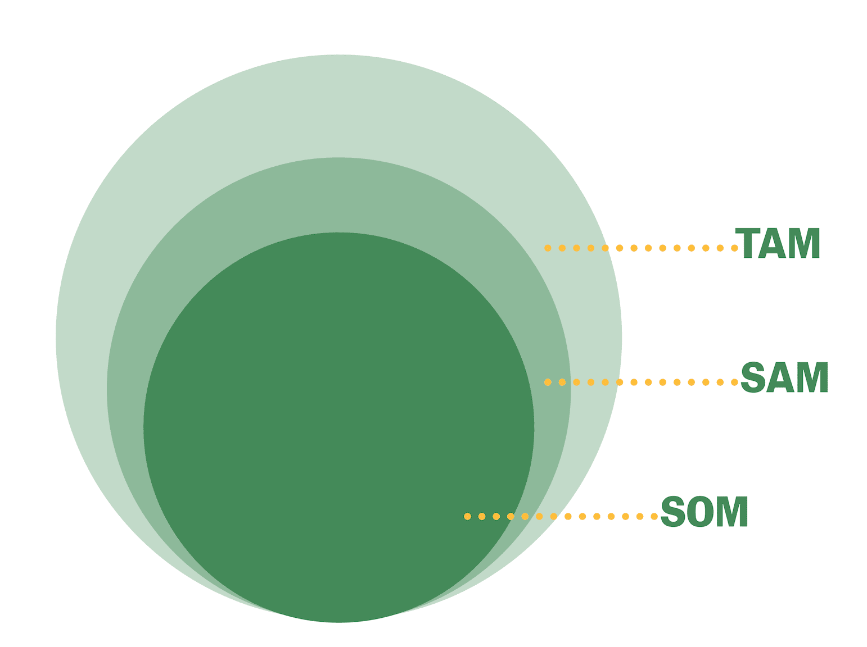
Total Addressable Market (TAM) in Fundraising
TAM Concept: Estimating the full market potential of donors.
Application in Fundraising: Identifying the broadest potential donor pool
Refinement to SAM: Serviceable Addressable Market - focusing on donors within reach
Narrowing to SOM: Serviceable Obtainable Market - realistic target donor segments
Strategic Use: Informing prospect development and fundraising strategies
Source: MaRS Discovery District

Slide 9
Quantifying and Estimating Your Donor Market
Demographic Analysis: Assessing the demographics that align with your cause
Wealth Screening: Using tools to estimate the financial capacity of potential donors
Past Donation Trends: Analyzing historical giving data to predict future behaviour
Geographic Targeting: Focusing on areas with a higher concentration of potential donors
Psychographic Profiling: Understanding the values and interests of potential donors

Slide 10
Assumptions vs. Reality in Fundraising
Theoretical Maximums: Understanding the ideal potential of your fundraising campaign
Realistic Expectations: Setting achievable goals based on historical data and current trends
Economic and Market Influences: Considering external factors that impact donor behaviour
Ongoing Evaluation: Continuously reassessing goals and strategies.
Strategic Flexibility: Adapting to changing circumstances and new information

Slide 11
Moving Beyond Fantasy: Embracing Realistic Portfolios and Goals
Enhanced Focus on Achievable Targets: Shifting attention to realistically attainable goals
Strategic Resource Allocation: Directing efforts and resources to viable prospects
Building Sustainable Relationships: Prioritizing long-term donor engagement over one-time fantasy gifts
Realism in Forecasting: Applying data analytics for accurate prediction and trend analysis in fundraising efforts
Expectation Management: Setting and communicating realistic goals to stakeholders

Slide 12
Fantasy fundraising audit: a case study Background and Problem Statement
Alumnus Profile: John Doe, high-capacity donor, undergrad alum less engaged than with his graduate alma mater
Engagement: Minimal affinity or interaction with the undergraduate university
Previous Strategy: Optimistically listed as a top donor based solely on financial potential
Resource Misallocation: Efforts focused on a low-engagement prospect
Connection Gap: No effective links or network volunteers connecting John to the university

Slide 13
Fantasy fundraising audit: a case study Objective Intervention
Objective: Eliminate ineffective "fantasy fundraising" practices; focus on engaged and realistic donor prospects using data-driven strategies.
Fantasy Fundraising Audit: Conducted a thorough review to reassess engagement, historical giving, and network connections of prospects.
Strategy Shift: Removed John Doe from the prospect list to reallocate resources more effectively
Data-Driven Prospecting: Enhanced use of analytics to identify and prioritize prospects with genuine engagement and higher likelihood of donating
Volunteer Involvement: Increased efforts to engage volunteers for personal introductions and advocacy, enhancing donor connections

Slide 14
Fantasy fundraising audit: a case study Implementation and Results
Segmentation and Targeting: Applied advanced prospect research tools for better segmentation based on engagement and historical giving
Enhanced Engagement: Developed personalized outreach and strategic involvement in university activities to match donor interests
Utilizing Data: Employed predictive analytics for more accurate forecasting of donor behaviour and potential contributions
Outcome of New Approach: Secured record-high donations from previously under-engaged donors, establishing a reliable support baseline
Sustainable Impact: Shift to data-driven strategies resulted in a more engaged donor base and increased campaign sustainability

Slide 15
Fantasy fundraising audit: a case study Conclusions, Lessons Learned
Strategic Realignment: Transition from fantasy to data-driven fundraising enhances efficiency and donor relations
Importance of Engagement: Prioritizing donor affinity and engagement over mere capacity proves more effective
Data Utilization: Leveraging data analytics ensures focus on high-probability prospects, improving outcomes
Regular Strategy Audits: Essential for adapting to changes and maintaining alignment with realistic fundraising goals
Balanced Approach: Combining quantitative analysis with personal engagement strategies fosters sustainable donor support

Slide 16
Thanks!
Resource page:

