Slide 1
Prospecting for Fundraising
A match made in philanthropy

Slide 2
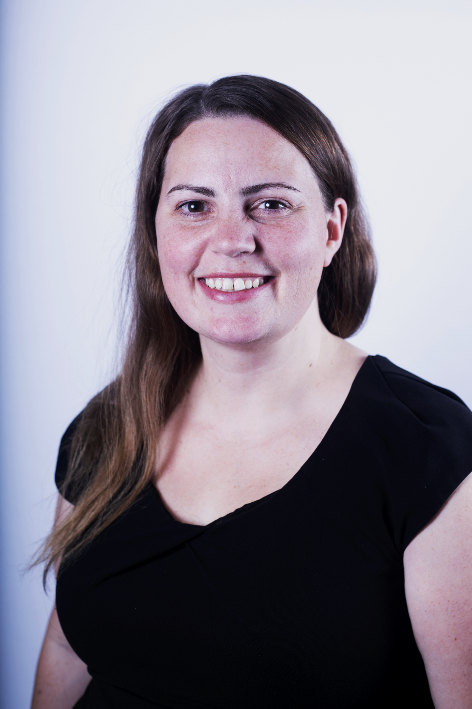
About Me: Katherine Scott (she/her/elle)
15 years in fundraising, mainly in prospect development, working with a range of organizations
Academic background in International Development and Information Science
President of Apra Canada
Originally from Northern Ontario (Treaty 9)
Avid reader
Mom to three kids and one beagle
Notes:
In this virtual session, I imagine our group today is coming in from many different ancestral lands. I am grateful to indigenous peoples who have been caretakers of these lands, including the traditional territories of the anishinabe, haudenosaunee, and wendat peoples where I live along with many indigenous people and settlers.

Slide 3
Intention for today
What is prospecting?
Strategies & Tools
Discussion
Notes:
My intention for today is to share what I consider some of the key knowledge for getting started, restarting, or reenergizing prospecting in your organization. This session is meant to be informal and conversational, so I invite questions and discussion. I acknowledge that we may all be at different levels of comfort and experience here, but I hope that we can all learn together regardless.

Slide 4
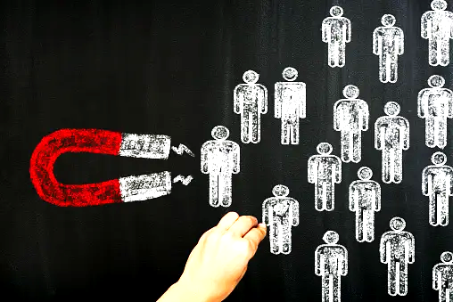
What is donor prospecting?
The strategic arm of an organization’s fundraising operation, focusing on prospect pools and pipelines. Prospect development professionals collaborate with gift officers and development leaders to ensure fundraising efforts are focused on working with the right donors for the right gifts at the right time (and in many cases, with the right initiatives).
Apra

Slide 5
Prospecting: why do we need it?
Keeps your pipeline healthy and dynamic.
Identifies new leads for larger gifts and deeper relationships with your organization.
Helps gift officers prioritize their workloads.
Why is it so difficult?

Slide 6
Let’s get started: brainstorming
Fundraising Project

Slide 7
Let’s get started: brainstorming
Business Associations
Donors
Fundraising Project
Friends
Volunteers
Staff
Patrons
Communities
Industries
Philanthropy

Slide 8
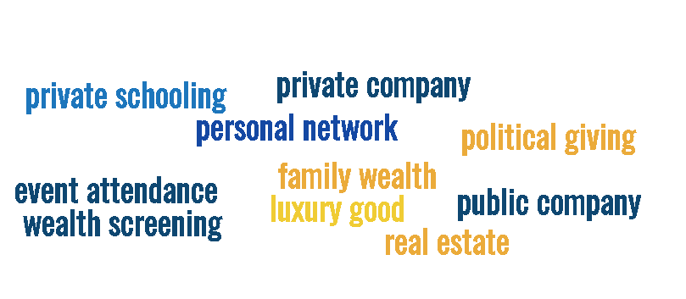
What is a lead?
Capacity
Notes:
Capacity
Does this individual, foundation, business, corporation have the financial capacity to make a donation at the level you are seeking?
Does this individual, foundation, business, corporation have the influence to make key connections that will advance your philanthropic goals?
Connection
Is there a meaningful connection to your organization? E.g. existing donor relationship, beneficiary, volunteer, board member, parent, patient, patron
Alignment
Is your organization's mission in line with an individual or foundations philanthropic goals? Is it aligned with a company’s stated business goals or CSR mandate?
Availability
Is this a good time for the individual, foundation or corporation to make a gift or begin engagement? Don’t give up on them yet but be aware, track, and plan accordingly.

Slide 9
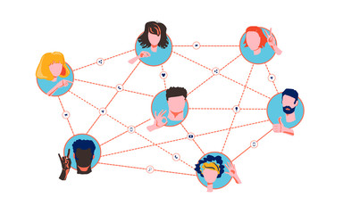
What is a lead?
Capacity
Connection
Notes:
Capacity
Does this individual, foundation, business, corporation have the financial capacity to make a donation at the level you are seeking?
Does this individual, foundation, business, corporation have the influence to make key connections that will advance your philanthropic goals?
Connection
Is there a meaningful connection to your organization? E.g. existing donor relationship, beneficiary, volunteer, board member, parent, patient, patron
Alignment
Is your organization's mission in line with an individual or foundations philanthropic goals? Is it aligned with a company’s stated business goals or CSR mandate?
Availability
Is this a good time for the individual, foundation or corporation to make a gift or begin engagement? Don’t give up on them yet but be aware, track, and plan accordingly.

Slide 10
What is a lead?
Capacity
Connection
Alignment
Notes:
Capacity
Does this individual, foundation, business, corporation have the financial capacity to make a donation at the level you are seeking?
Does this individual, foundation, business, corporation have the influence to make key connections that will advance your philanthropic goals?
Connection
Is there a meaningful connection to your organization? E.g. existing donor relationship, beneficiary, volunteer, board member, parent, patient, patron
Alignment
Is your organization's mission in line with an individual or foundations philanthropic goals? Is it aligned with a company’s stated business goals or CSR mandate?
Availability
Is this a good time for the individual, foundation or corporation to make a gift or begin engagement? Don’t give up on them yet but be aware, track, and plan accordingly.

Slide 11
What is a lead?
Capacity
Connection
Alignment
Availability
Notes:
Capacity
Does this individual, foundation, business, corporation have the financial capacity to make a donation at the level you are seeking?
Does this individual, foundation, business, corporation have the influence to make key connections that will advance your philanthropic goals?
Connection
Is there a meaningful connection to your organization? E.g. existing donor relationship, beneficiary, volunteer, board member, parent, patient, patron
Alignment
Is your organization's mission in line with an individual or foundations philanthropic goals? Is it aligned with a company’s stated business goals or CSR mandate?
Availability
Is this a good time for the individual, foundation or corporation to make a gift or begin engagement? Don’t give up on them yet but be aware, track, and plan accordingly.

Slide 12
Resources (free!)
Your donor database or CRM
Your public or academic library.
Google Alerts
Theorg.com
LinkedIn & Other Social Media
Newsletters
Public Sector Salary Disclosures, Federal Corporations, SEDAR, SEDI, SEC
Some real estate tools
Your colleagues
Candid
Charitydata.ca

Slide 13
More resources ($)
Apra Canada for downloadable templates and guidance
Relationship Science (Altrata)
CharityCAN
iWave
GrantConnect (Free at some public libraries)
Financial Post Advisor (Free at some public libraries)
Apra Canada
LiveAlumni
Environics Analytics
DonorSearch / Windfall / WealthEngine / Instrumentl
Notes:
If you would like me to show you some of these at the end of the session or later, I’ll be happy to.

Slide 14
Strategies
Philanthropic Environment
Active campaigns
Gift Announcements
Board Appointments
Trends
Environmental Scan
Peer review
Data Analytics & Modelling
P.E.R.F.E.C.T. Method
Learn from Sales
Business Environment
Internal Environment
Market conditions
Emerging Trends
Appointment Notices
Corporate Social Responsibility
Matching initiatives
Campaigns, projects, and priorities
Leadership support
Patrons, users, guests, visitors, staff

Slide 15
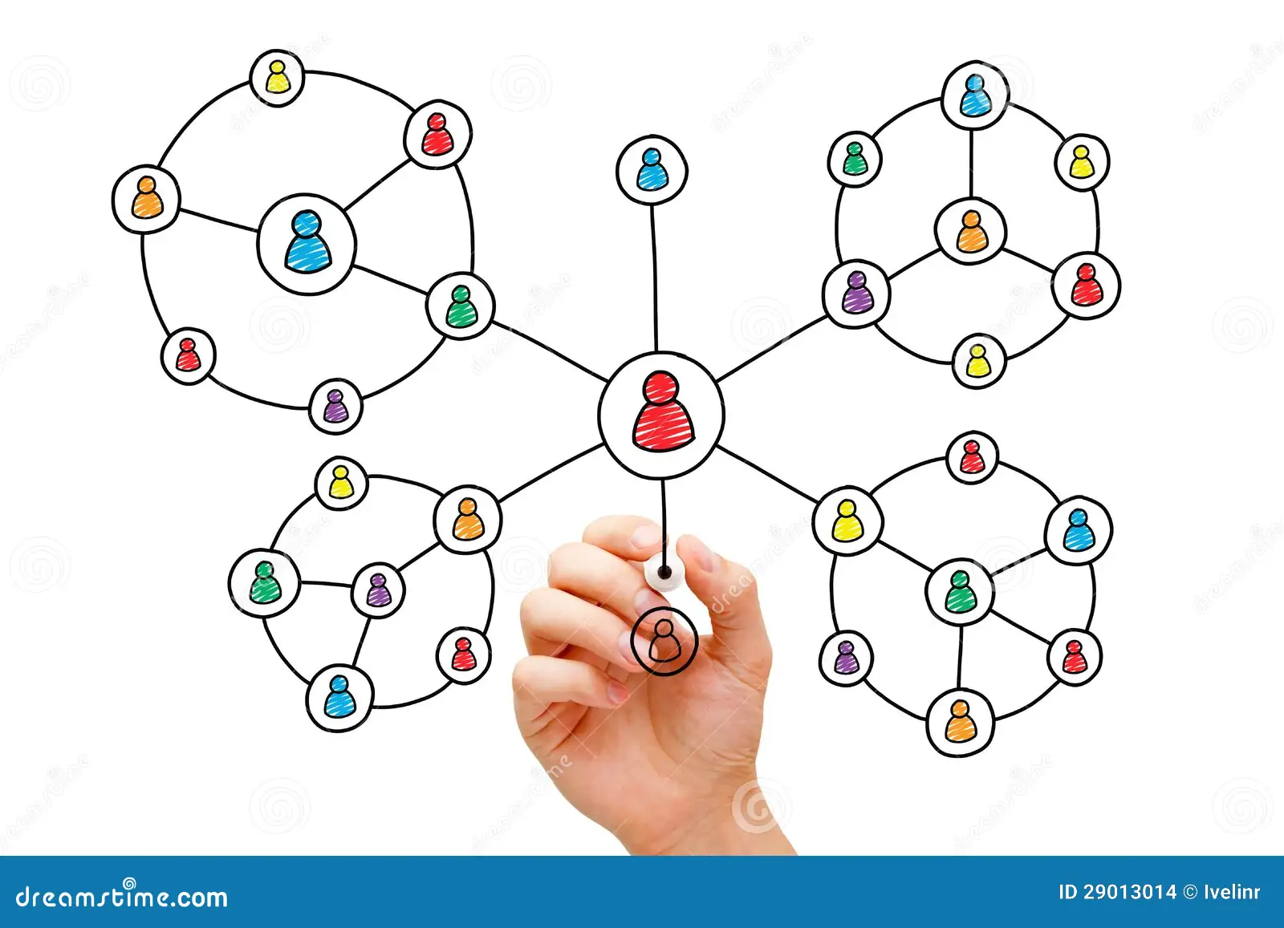
Strategies
Environmental Scan
Peer review
Data Analytics & Modelling
Learn from Sales

Slide 16
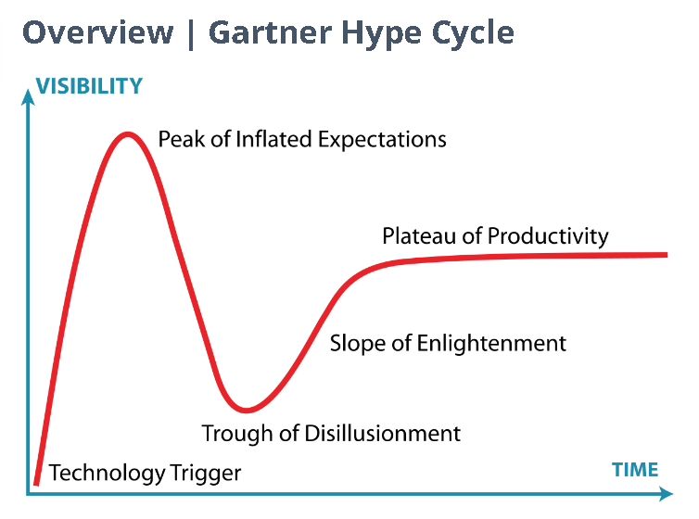
Strategies
Environmental Scan
Peer review
Data Analytics & Modelling
Learn from Sales
Notes:
This can be a predictive model, a wealth scan , etc. As a researcher I’ve seen these activities used very well and very poorly. With a proliferation of “AI powered” tools on the market this space will only get more confusing.
At minimum you will need to have a good understanding of your data governance, the tools you are adopting, and have a plan in place for implementation.

Slide 17
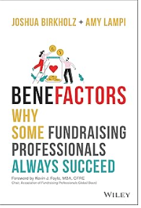
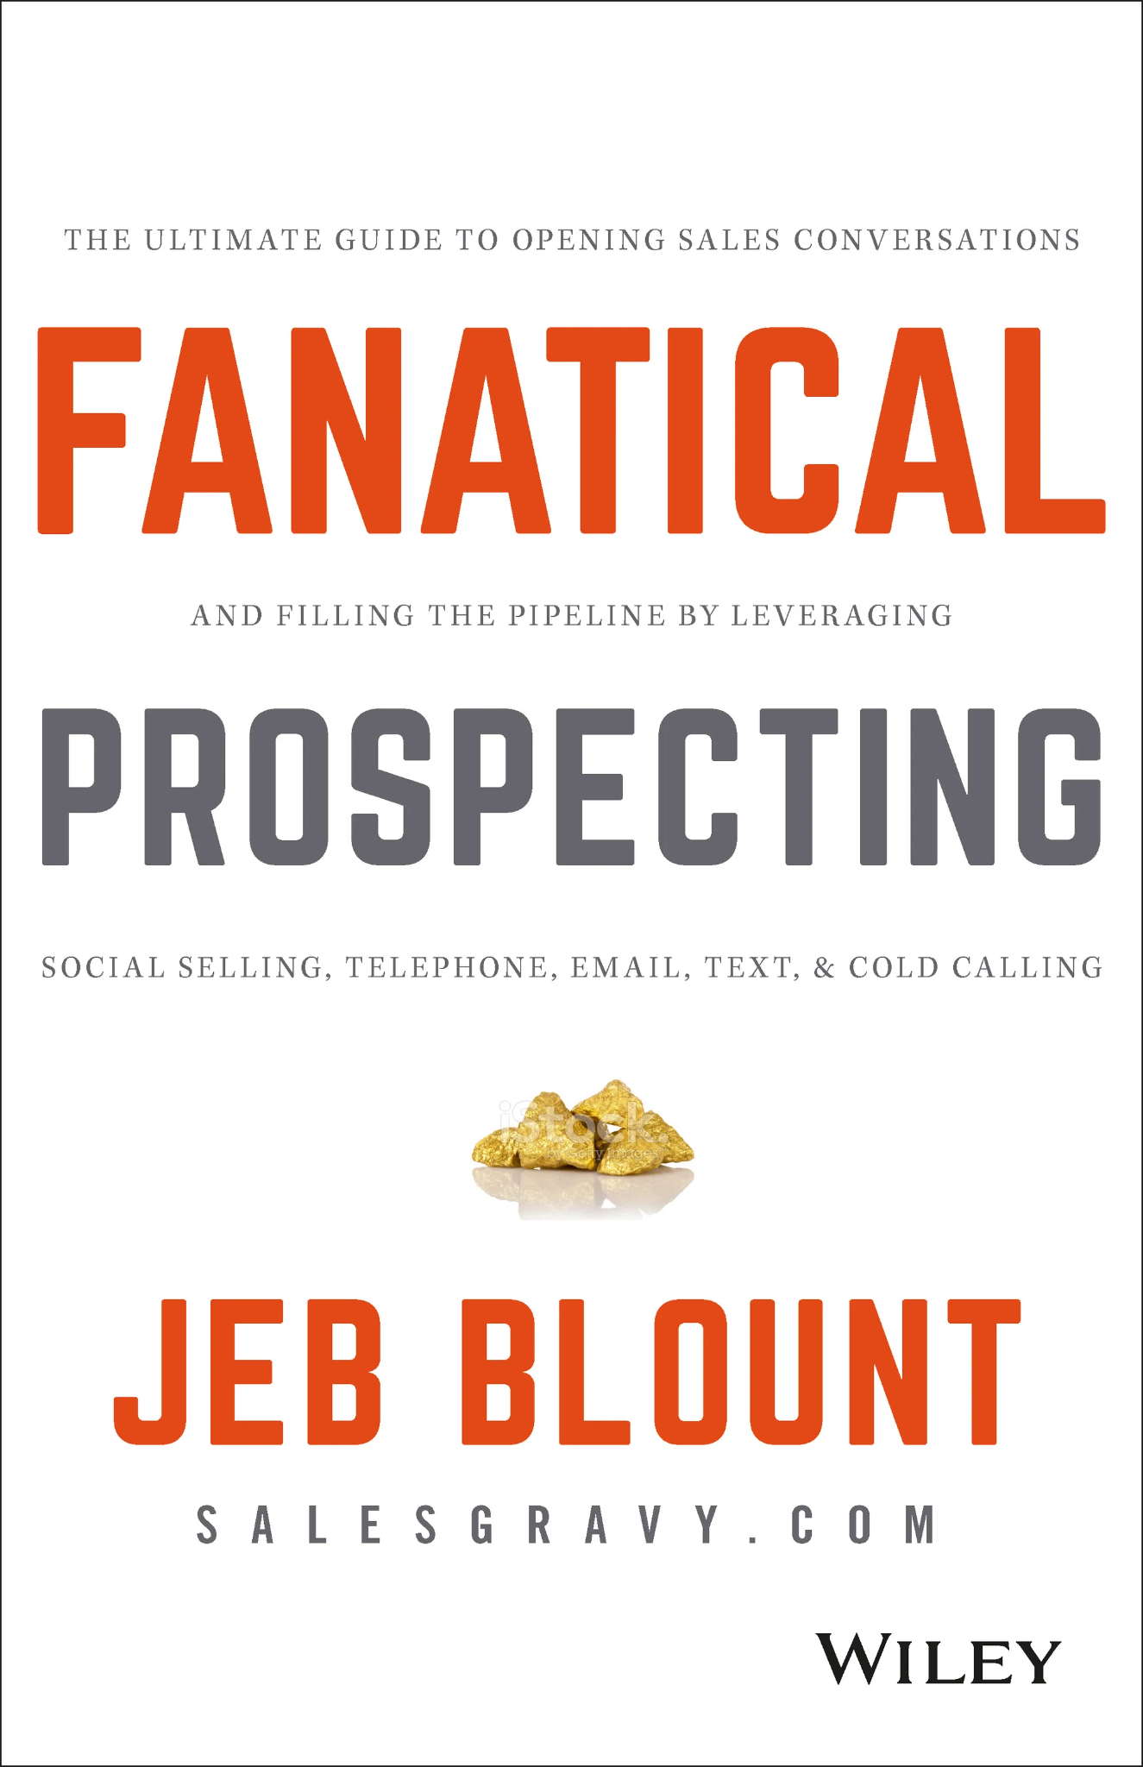
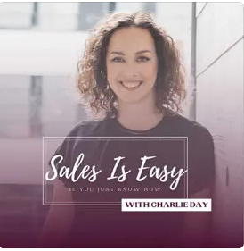
Strategies
Environmental Scan
Peer review
Data Analytics & Modelling
Learn from Sales
The P.E.R.F.E.C.T. Method
Problems
Engagement
Reach
Follow Up
Energy!
Conversation
Then add more

Slide 18
Factors for Success
Know your organization and its fundraising priorities.
What is your hook?
Dedicate time for prospecting (at least 25%.)
Work dynamically with your prospect researcher/research team.
File contact reports, update records, track your success.
Adopt a data visualization tool that works for you and your leadership.
Be aware of bias.
Notes:
Know your organization and its fundraising priorities.
What is your case for support?
What is unique about your case for support? About your organization?
How much money do you need to raise?
What is your hook?
When doing initial outreach, do you have a short pitch that will encourage a meeting?
Dedicate time for prospecting.
Work dynamically with your prospect researcher/research team.
File contact reports, update records, track your success.
Adopt a data visualization tool that works for you and your leadership.
Be aware of bias.
We all have biases that impact our ability to think and analyze objectively. With prospecting, we can easily and unconsciously overlook or overestimate a prospective donor’s viability based on our assumptions of what a donor looks like. We can also fall into the trap of confirmation bias where we look for information to confirm a desirable outcome. Selection bias is a pitfall in any of the prospecting strategies I mention. Brainstorming with a diverse group of fundraising staff will help to compat this.

Slide 19
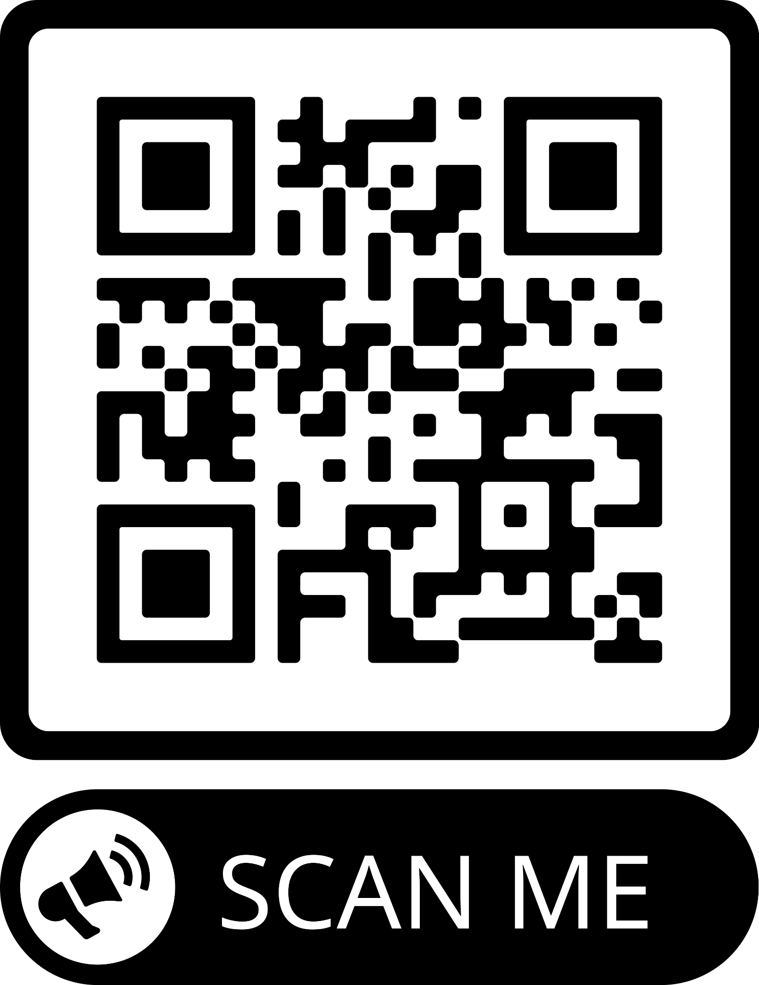
Stay in Touch
Notes:
Know your organization and its fundraising priorities.
What is your case for support?
What is unique about your case for support? About your organization?
How much money do you need to raise?
What is your hook?
When doing initial outreach, do you have a short pitch that will encourage a meeting?
Dedicate time for prospecting.
Work dynamically with your prospect researcher/research team.
File contact reports, update records, track your success.
Adopt a data visualization tool that works for you and your leadership.
Be aware of bias.
We all have biases that impact our ability to think and analyze objectively. With prospecting, we can easily and unconsciously overlook or overestimate a prospective donor’s viability based on our assumptions of what a donor looks like. We can also fall into the trap of confirmation bias where we look for information to confirm a desirable outcome. Selection bias is a pitfall in any of the prospecting strategies I mention. Brainstorming with a diverse group of fundraising staff will help to compat this.

