Slide 1
INFLUENCE,
AFFLUENCE &
OPPORTUNITY:
Donor-advised Funds in Canada
APRA Canada Conference| 23-OCT-24

Slide 2
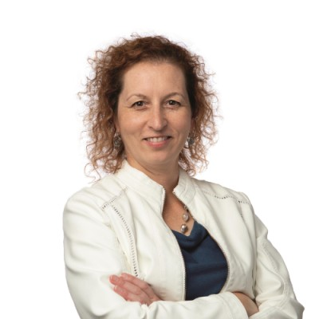
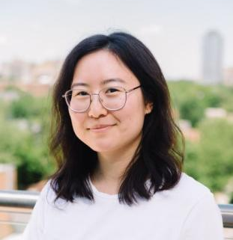
affluence
influence
Celeste Bannon Waterman
KCI Partner & Lead, Research & Analytics
opportunity
KCI lead on Influence, Affluence & Opportunity: Donor-Advised Funds in Canada
14 years of consulting with charities across Canda
Previously Exec. Director, Advancement Services at University of Guelph

Slide 3
influence
affluence
opportunity
DONOR-ADVISED FUNDS IN CANADA.

Slide 4
affluence
influence
opportunity
CANADIAN DONORS TODAY.

Slide 5
opportunity
affluence
influence
DAFs AT THE INTERSECTION OF DONORS & CAUSES.

Slide 6
affluence
influence
opportunity
CANADIAN DONORS TODAY.

Slide 7
WHY DID WE UNDERTAKE THIS RESEARCH?
affluence
influence
opportunity
While only 2.4% of donors use DAFs…
…DAF grants are up 35% annually from 2019-2021…
…and DAF donations were 9.8% of total donations in 2021.

Slide 8
THE GIVING ENVIRONMENT.
affluence

Slide 9
influence
affluence
opportunity
DONOR-ADVISED FUNDS IN CANADA.

Slide 10
OUR INFORMATION SOURCES.
influence
T3010 Filings
Annual Reports and Audited Statements
Major Survey of Foundations
Interviews and Focus Groups with: Donors, Charities, Regulators, Advisors, DAF Foundations
Imagine Canada

Slide 11
DONOR-ADVISED FUNDS: THE PROCESS.
influence

Slide 12
KEY DAF ELEMENTS.
influence
The gift into the fund is irrevocable, and the foundation/charity holding the DAF has final decision-making authority and responsibility.
The DAF organization must comply with all regulatory and disclosure requirements, including disbursement, at the organizational level.
Required annual disbursement currently 5% for those with assets over $1M, 3.5% for those below.
DAFs generally fall into three categories:
Endowed funds (perpetuity, distributing income only)
Spend-down or Flexible funds (flexible, distributing all funds but no schedule)
Flow-through Funds (temporary, distributing all funds in a fixed period)

Slide 13
DRIVERS OF GROWTH.
influence
Greater Awareness by Affluent and HNW Households that Control 80% of Personal Wealth.
Active Participation by Banks, Brokerage Firms and Investment Counsellors.
Money in Motion as a Result of Liquidity Events, Wealth Transfer and Bequests.
Convenient to Access, Simple to Understand, Tax Efficient, Multi-generational.

Slide 14
DRIVERS OF GROWTH.
influence
Greater Awareness by Affluent and HNW Households that Control 80% of Personal Wealth.
Active Participation by Banks, Brokerage Firms and Investment Counsellors.
Money in Motion as a Result of Liquidity Events, Wealth Transfer and Bequests.
Convenient to Access, Simple to Understand, Tax Efficient, Multi-generational.

Slide 15
DRIVERS OF GROWTH.
influence
Greater Awareness by Affluent and HNW Households that Control 80% of Personal Wealth.
Active Participation by Banks, Brokerage Firms and Investment Counsellors.
Money in Motion as a Result of Liquidity Events, Wealth Transfer and Bequests.
Convenient to Access, Simple to Understand, Tax Efficient, Multi-generational.

Slide 16
DRIVERS OF GROWTH.
influence
Greater Awareness by Affluent and HNW Households that Control 80% of Personal Wealth.
Active Participation by Banks, Brokerage Firms and Investment Counsellors.
Money in Motion as a Result of Liquidity Events, Wealth Transfer and Bequests.
Convenient to Access, Simple to Understand, Tax Efficient, Multi-generational.

Slide 17
AVERAGE INDIVIDUAL DAF ASSETS.
influence
VANCOUVER FOUNDATION | $323,092
CHARITABLE IMPACT | $2,166
GIFTPACT | $43,006
STRATEGIC CHARITABLE GIVING | $139,828
NICOLA PRIVATE GIVING | $594,539
GIVEWISE | $74,952
PRIVATE GIVING FOUNDATION | $476,852

Slide 18
ABOUT HALF OF DAF ASSETS IN CANADA HELD BY COMMUNITY FOUNDATIONS (MOSTLY ENDOWED).
influence
There were approximately 20,450 DAFs in Canada at the end of 2021, excluding Charitable Impact, holding $8.5B in assets.

Slide 19
NON-ENDOWED DAFS ACCOUNT FOR THE MAJORITY OF DONATIONS & GRANTS.
influence
 | Endowed | Flow-through & Spend-down
$ Donations (in) | $308 million | $1,885 million
# Grants (out) | 10,104 | 78,734
$ Grants | $155 million | $767.1 million
Granting Rate | 6.4% | 12.6%
Average Grant Value | $15,329 | $9,743

Slide 20
DAF GRANTS BY SECTOR MOSTLY SAME AS OVERALL DONATIONS.
influence
Source: Imagine Canada’s Grant Connect platform, 2019 to 2021 tax years. Grant Connect contains data and information on hundreds of Canadian DAFs, including exclusive funding data from Canada Gives through an ongoing partnership.

Slide 21
ROOM FOR GREATER TRANSPARENCY.
influence
DAF sector lacks reliable data
Greater fund-level reporting and clarity around disbursement rates required (endowed vs. other types)
DAF community should develop standards and Code of Conduct
Many reporting voluntarily, and/or calling for greater transparency via T3010s and other exiting vehicles
Bill C-32 may bring changes with trust-level reporting, but dramatically increased overhead for all DAFs and endowed funds

Slide 22
opportunity
affluence
influence
DAFs AT THE INTERSECTION OF DONORS & CAUSES.

Slide 23
GETTING TO KNOW YOUR DAF DONORS…
DAFs TAPPING INTO ‘NEXT TIER’ PHILANTHROPISTS
Primarily donors generally over 55; many at or near retirement
High-income individuals, not mega-wealthy for the most part
Many fund their DAFs from securities or other investments, or from ‘wealth events’
Already substantive donors, DAFs generally started as they shift from saving to giving years, used for ‘strategic’ giving
DAFs sometimes described as ‘charitable savings accounts’; part of overall financial planning
Most also give small/spontaneous gifts directly (i.e. directly as well as from DAFs to the same charity)
opportunity

Slide 24
GETTING TO KNOW YOUR DAF DONORS…
ANONYMITY NOT A DRIVER
Donors not seeking anonymity from causes they support, but don’t necessarily want to be ‘public’ as with a foundation
SEEKING CONNECTION, INFORMATION
Donors want more information about needs, and charities they can support
looking to the DAF organizations themselves or other donors for this help
Also interested in working with other philanthropists, potentially pooling funds to address big issues
opportunity

Slide 25
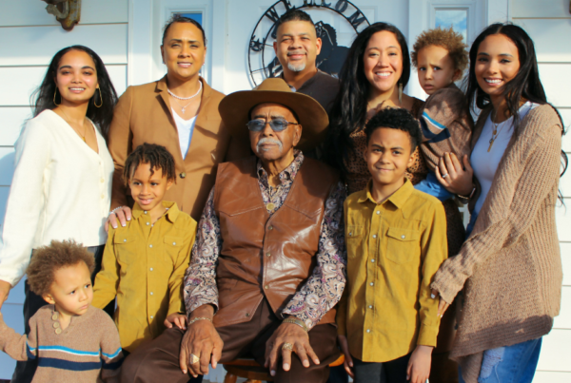
GETTING TO KNOW YOUR DAF DONORS…
SEEKING TO BUILD A FAMILY LEGACY
Involvement of younger generations in philanthropy seen as benefit, opportunity
Expectation that DAF will be passed to younger generations to direct, particularly for endowed DAFs
opportunity

Slide 26
WHAT CHARITIES CAN DO
opportunity
Welcome & Encourage DAF Grants.
Include “give through my DAF” as an option on pledge forms, buckslips, etc.
Welcome DAF pledges in giving challenges (i.e. Giving Days)
Highlight DAF donors in stories, testimonials as with other gift vehicles
Acknowledge and recognize as you would for other gifts
Encourage DAF donors to make pledges

Slide 27
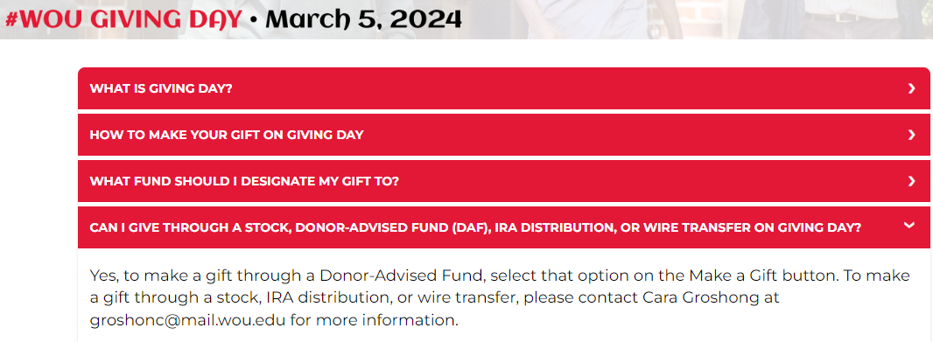
WHAT CHARITIES CAN DO
opportunity
Source: Western Oregon University Giving Day FAQ. https://givingday.wou.edu/pages/faq-2245

Slide 28
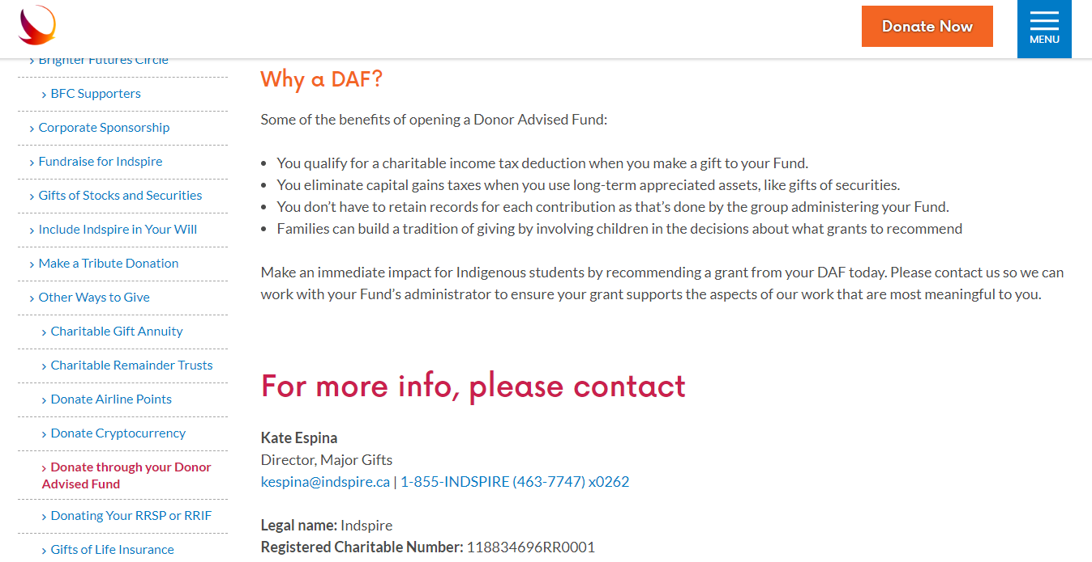
WHAT CHARITIES CAN DO
opportunity
Source: Indspire Ways to Give page. https://indspire.ca/ways-to-give/

Slide 29
WHAT CHARITIES CAN DO
opportunity
Watch for DAF Grants & Record Appropriately
Educate operations staff to watch for signs of DAF gifts, record all accompanying info
Record DAF foundation as source, but soft credit individual(s)
Ensure DAF grants and other gifts from same donor show full picture of giving history

Slide 30
…TO GROW GRANTS TO YOUR ORG.
Follow Up
opportunity
Send acknowledgement, thank you letter, etc. as per normal process
If fundholders’ name or address not provided, follow up with foundation, or forward materials to be passed along
Build relationship with donor and family
Identify local / influential DAF advisors and share information about your cause
Include and address spouse and/or family as much as possible
Identify projects or opportunities that DAF donors can join with others, and share with local or aligned foundations
Build Community

Slide 31
A CAUTIONARY TALE
opportunity
Annual DAF Grant vs. Endowed Scholarship
Alumni wished to support campaign via an endowed scholarship of $1M
Worked with University fundraiser to confirm area, amount
But after discussion with financial advisor, decided to place funds in endowed DAF instead, with income directed to University annually
Donor perceived both options as essentially the same
Challenges:
Difference in endowed scholarship (guaranteed perpetuity) vs. annual scholarship from University’s perspective
Stewardship and recognition differences
Campaign totals
Fundraiser targets

Slide 32
WHAT PROSPECT RESEARCHERS CAN DO
opportunity
Understand & Educate
Research any DAF gifts to (hopefully) identify donors if not obvious
Where DAF donors known, research full family including children
Research local community foundations, especially Board / volunteers
Understand fund minimums, structure of financial DAF foundations
Focus on individuals, not DAF foundations / Boards
Identify potential volunteers with DAF connections
Arm fundraisers with DAF knowledge
Be able to articulate (and communicate) benefits of internal endowments

Slide 33
THE FUTURE IS BRIGHT FOR DAF GROWTH… AND IMPACT.
opportunity
$1.4B
$8.5B
$12.5B
2011
2021
2025E

Slide 34
Let’s discuss!
INFLUENCE, AFFLUENCE & OPPORTUNITY:
Donor-advised Funds in Canada
APRA CANADA | 23-OCT-24

