Slide 1
From Vision to Reality: Launching a Portfolio Visualization Tool for Fundraising Success
Presented by:
Zoe Fine Manager, Prospect Management
Laura Cline Business Intelligence Analyst

Slide 2
University of Toronto
$4B
Defy Gravity Campaign Goal
Advancement at the University of Toronto
Advancement Activities at the University of Toronto can be best described as operating under a coordinated decentralized model,
Divisions and faculties managing their own business plans and strategies.
Prospect Management (PM) Team
Prospect Management at the University of Toronto is a university-wide approach to managing and tracking major, principal, and gift planning prospects.
4 FTE, liaison model supporting approx. 90 major gift fundraisers
Business Intelligence & Analytics (BIA) Team
The BIA Team focuses on leveraging data to support fundraising, alumni engagement and strategic decision making across the University of Toronto
Build dashboards, reports and machine learning models to track and enhance the effectiveness of Advancement activities
1 Director and 1 Business Intelligence Analyst
90
Major Gift Fundraisers
6
BI and PM Team Staff
Notes:
Advancement at the University of Toronto
Before we dive into a walkthrough of how the team created and launched our portfolio visualization tool, we want to take a step back and provide context for advancement at the University of Toronto
Advancement activities at the University of Toronto can be best described as operating under a coordinated decentralized mode.
What this means is that divisions and faculties have the autonomy to create their own business plans and set their goals related to fundraising and activities.
U of T is currently in the middle of it's Defy Gravity Campaign. Launched in 2021 with a goal to raise $4B for the university’s highest priority areas.
For the period May 1, 2023 to April 30, 2024, the University raised a total of $312 million. 7 This amount includes $258 million in pledges and gifts (donations) and $54 million in philanthropic research grants from non-government sources (https://finance.utoronto.ca/wp-content/uploads/2024FR.pdf)
Prospect Management
In order to ensure a coordinated approach across all divisions – this is where Prospect Management comes in.
Prospect Management at the University of Toronto consists of guidelines, procedures, practices, and the Prospect Management system on ARBOR (BBCRM) that supports, directs, tracks and measures
relationship building activities with major gift type prospects and donors. The office of Prospect Management at the division of the University Advancement (DUA) oversees and facilitates the
system.
Currently the team has 4 full time staff, with full compliment we will be at 6 full time staff. We work on a liaison model with staff members managing a portfolio of divisions and providing direct support through portfolio reviews, training, and ad hoc meetings. We also support various enhancements to our CRM ARBOR (BBCRM) and reports.
Business Intelligence Team

Slide 3
Where We Started
Notes:
Like many of you on the call who may have launched a new report or feature, it usually takes multiple iterations to achieve a final product, and the Portfolio Visualization Project that Laura and I worked on is no different.

Slide 4
The Problem: How to Present Key Portfolio Data and Metrics?
Pivot Tables: Pros and Cons
Tableau Report: Pros and Cons
Visualization Kickoff: Represents the first step in the Prospect Management team's visualization journey
Flexibility: Creating pivot tables allowed for flexibility and customization with tracking key metrics
Preparation Time: Setting up pivot tables requires careful organization of data, selecting fields, and defining calculations, which can be time-consuming.
Data Integrity: Manual data manipulation makes it difficult to achieve consistent result.
Advanced Analytics: Offers robust analytical capabilities, including trend analysis and forecasting.
Interactive Dashboards: Users can create dynamic dashboards that allow for real-time data exploration and interaction.
Customizable Visualizations: Wide range of chart types and customizable options to suit different data storytelling needs.
Access: Only select members had access to Tableau
Notes:
A key facet of the Prospect Management team is supporting, directing, tracking and measuring relationship building activities with major gift and principal gifts prospects at the University of Toronto.
We are always looking for new and effective ways to present this information to fundraisers, and visualization seems like the natural first step in this journey. However, the capacity and ability of the team meant that our first foray into visalizations was through pivot tables, which had quite a few pros, but also cons.
The first pro of a pivot tables, was just that we were trying! We knew that we needed to be able to present data in a new way to drive impact, so pivot tables allowed us to dip our toes into visualizations with a low overhead. Leading into that, they also afforded flexibility, Because the team could create them, it allowed for customization. The cons of course are preparation time, because these tables had to be created manually it would take a lot of time pulling data from various other reports and then plugging them into a table and choosing the visualization that worked best. All this manual manipulation can also lead to data integrity issues and lack of consistency.
After using pivot tables for some time, the team linked up with the Business Intelligence team to create a dashboard in Tableau. This was a gamechanger for us, as it allowed for advanced analytics, interactive dashboards, and customizable visualizations three things that we were lacking with pivot tables. However, the main piece of feedback we received from fundraisers regarding the dashboard was that they wanted it to be accessible. When the dashboard was created it lived on a separate server that had restricted access. The Prospect Management team would pull a PDF version of the dashboard for our portfolio review meetings. Making the Visualization accessible was the natural next step for the Portfolio Visualization and being able to provide insights for advancement staff when needed.

Slide 5
Portfolio Visualization Project – Project Goals
Data Visualization Present fundraisers' portfolio data in a visually intuitive way, enabling quick understanding of performance trends and metrics through charts, graphs, and other visual tools.
Portfolio Tracking Track the composition of fundraising portfolios. This clear, visual summary helps fundraisers quickly identify areas that need improvement and focus efforts where they can have the most impact.
Communication and Collaboration Foster alignment and collaboration across the DUA by ensuring that everyone has a shared, consistent understanding of portfolio insights. This helps keep everyone on the same page and working toward common goals.
Decision-Making Support Help divisions identify strengths, opportunities and risks, enabling them to make strategic adjustments, allocate resources effectively, and optimize fundraising efforts

Slide 6
Portfolio Visualization Project: The Rollout
Identify Key Stakeholders
Test, Test, Test!
Communications and Roll Out Plan
Information Management
Prospect Management
Development Officers, Managers, and Executive Directors
Senior Leadership
Created a team of "Super Users"
Provided testing prompts and a shared worksheet to add feedback
The Prospect Management team reviewed and analyzed feedback.
Integrated high priority feedback
Presented final draft version of the report to Senior Leadership
Email communication sent to all advancement staff
All staff drop-in training session and walkthrough.
Individual walkthrough scheduled with divisions and faculties by request
Call for additional feedback
Integration into Portfolio Reviews
Notes:
The Portfolio Visualization Project can be broken down into three separate groups: Identifying Key Stakeholders, Testing, and Communications and Roll out Plan.
Identifying Key Stakeholders
Before we were able to even think about making the dashboard accessible to all advancement staff, we first needed to understand what was and wasn't possible as far as format and accessibility. We first pulled in team members from the Information Management team to learn – what information can be made open to all advancement staff and, what platform can house the dashboard. We were excited to learn that we could launch the dashboard within our BBCRM rather than on our PowerBI platform, as this minimizes the number of clicks fundraisers need to do in order to access this information.
Once we got the go ahead to make this information accessible to select advancement staff and determined the platform it would launch on, we then wanted to get buy in from the team. We determined that the group that we would need to run the report by before making it live was:
The Prospect Management Team – Obviously we would need by in from the team so that they felt comfortable with the format and areas that we were highlighting within the report.
A select group pf Development Officers, Managers, and Executive Directors in order to ensure that the reports would meet their needs
Senior Leadership – we knew that in order to ensure that the report would be used, we needed senior leadership at the Division of University Advancement to understand the purpose of the report and socialize it at meetings with advancement staff.
Testing, Testing, Testing
Once we got buy in from our key stakeholders, the next step would be to test the report to ensure that it meets the needs of stakeholders.
The team identified a group of super users, Development Officers, Managers, EDs, and imbedded Researchers in divisions, requested their support and, once we received the green light, shared the beta version of the report along with testing prompts and a shared worksheet where the super users could add in their feedback.
I then reviewed the feedback and created three categories (visualization, functionality, and user experience) and prioritized the feedback (low, medium, and high).
High priority feedback that was feasible to integrate into the report was implemented. There were some areas of feedback that we were not able to implement due to data security such as the ability to export data, but in these cases we did communicate with the super users group to let them know that we did look into their feedback.
Final step was presenting a final draft to Senior Leadership. We saw this as a necessary step as we wanted top down buy in for the dashboard to ensure that it was utilized during strategy meetings including senior leadership and that they would be able to speak to key facets of the report. Any feedback provided during the walkthrough was later implemented.
Communications and Roll out Plan
Once we had made the dashboard live in our CRM ARBOR, an email was sent to all advancement staff who have access to the dashboard providing background on the dashboard, how it will be used and informing them of an all staff training session and offering to hold individual training sessions and/or faculty and division training for the dashboard
We also solicited for feedback on the dashboard to ensure it is always meeting the needs of advancement staff.
Finally, we have integrated the Portfolio Dashboard into our portfolio reviews to track portfolio composition, value and days in stage.
nicationtions and Roll Out
The final step in this process is the communications roll out for the report

Slide 7
Divisional Portfolio Review Dashboard
Notes:
Like many of you on the call who may have launched a new report or feature, it usually takes multiple iterations to achieve a final product, and the Portfolio Visualization Project that Laura and I worked on is no different.

Slide 8
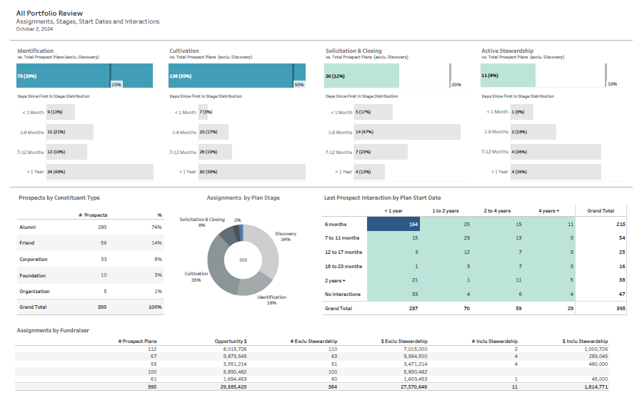
Notes:
The Portfolio Visualization – referred to as the Divisional Portfolio Review Report -- consists of 13 tabs. The report stickies to the fundraiser's account, but can be adjusted to show results for a specific group of fundraisers or a division.
The Visualization comprises the main tab. We can track the percentage of prospects in each stage of development and how long these plans have been in each stage. We can see a line on each graph which indicates the ideal portfolio benchmark to see how close or far they are from the benchmark and use this to spark a conversation on how to get closer to the benchmark
We can also see the donut chart in the centre of the report which includes tracking discovery and provides a holistic overview of portfolio composition.
To the right, we can see a chart that tracks how long a plan has been opened against the last interaction coded

Slide 9
Divisional Portfolio Review Dashboard Next Steps

Slide 10
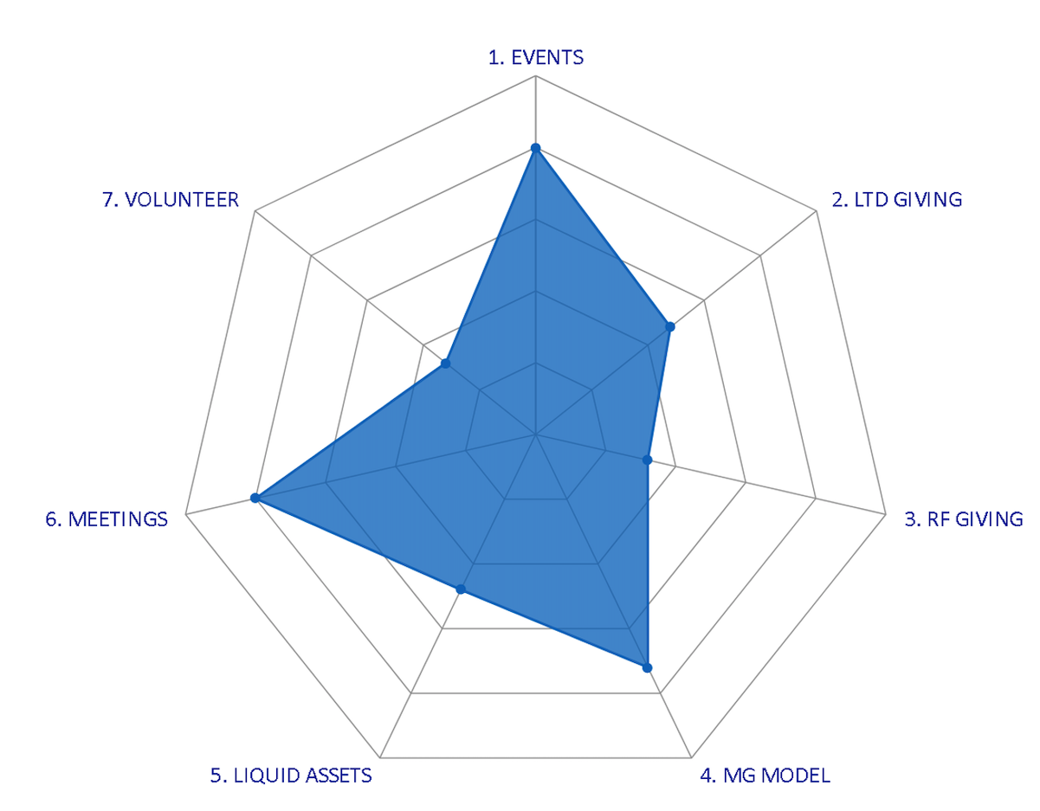
Divisional Portfolio Review: Next Steps
Disseminated Prospects Tab
Radar Charts
ThemeMapper AI
Monitor Prospect Assignments: Clear view on which prospects have been assigned to specific fundraisers or teams
Optimize Prospect Management: Identify any prospects that need reassignments or further attention to maximize fundraising efforts
Track Progress: Provide insights into the status of disseminated prospects to help with moves management and strategic planning
Visualize multiple Key Performance Indictors (KPIs) for a single prospect or to compare prospects in one chart
Highlight strengths and weaknesses across multiple areas, helping fundraisers prioritize and strengthen their prospect pool
Developed an Artificial Intelligence tool that matches all our fundraising opportunities, events, interaction comments, research projects and more to the University of Toronto Defy Gravity's Seven Campaign Themes
Highlights each prospect's current interests based on their past engagement history
Suggests relevant fundraising opportunities and upcoming events tailored to those interests
Notes:
The Portfolio Visualization Project can be broken down into three separate groups: Identifying Key Stakeholders, Testing, and Communications and Roll out Plan.
Identifying Key Stakeholders
Before we were able to even think about making the dashboard accessible to all advancement staff, we first needed to understand what was and wasn't possible as far as format and accessibility. We first pulled in team members from the Information Management team to learn – what information can be made open to all advancement staff and, what platform can house the dashboard. We were excited to learn that we could launch the dashboard within our BBCRM rather than on our PowerBI platform, as this minimizes the number of clicks fundraisers need to do in order to access this information.
Once we got the go ahead to make this information accessible to select advancement staff and determined the platform it would launch on, we then wanted to get buy in from the team. We determined that the group that we would need to run the report by before making it live was:
The Prospect Management Team – Obviously we would need by in from the team so that they felt comfortable with the format and areas that we were highlighting within the report.
A select group pf Development Officers, Managers, and Executive Directors in order to ensure that the reports would meet their needs
Senior Leadership – we knew that in order to ensure that the report would be used, we needed senior leadership at the Division of University Advancement to understand the purpose of the report and socialize it at meetings with advancement staff.
Testing, Testing, Testing
Once we got buy in from our key stakeholders, the next step would be to test the report to ensure that it meets the needs of stakeholders.
The team identified a group of super users, Development Officers, Managers, EDs, and imbedded Researchers in divisions, requested their support and, once we received the green light, shared the beta version of the report along with testing prompts and a shared worksheet where the super users could add in their feedback.
I then reviewed the feedback and created three categories (visualization, functionality, and user experience) and prioritized the feedback (low, medium, and high).

Slide 11
Questions?

