Slide 1
Data-Driven Donor Identification Leveraging Predictive Analytics in Prospect Research
Akshat Thakur
Data Analyst
University of British Columbia

Slide 2
Why Data Matters in Prospect Research
The evolving role of data in fundraising:
Predicting donor behavior more accurately and efficiently
Targeting outreach
Raising more funds
Today’s topics:
Data and Donor Identification
Predictive Scores, Segmentation and Profiling
Building and Empowering Data Teams

Slide 3
Predictive Analytics
Predictive analytics enhances Donor Identification by using historical and current data to forecast who is most likely to become significant donors. Here’s how it works:
Insights Powered by Patterns and Evidence Predictive models analyze patterns in past donor behavior—such as donation amounts, frequency, event participation, and engagement history.
Efficiency and Precision An automated identification process significantly reduces time spent on manual prospecting and multiplies scope.
Adaptability Predictive models evolve over time as more and better data is gathered, becoming increasingly accurate in identifying prospects and predicting donor behavior

Slide 4
What even is this Predictive Analytics thing? Is it something I can eat?
Think of it like a "smart filter" that helps fundraising teams focus on the right people.

Slide 5
Imagine you’re trying to find
the best apples in a huge orchard.
The apples are your potential donors.
The tool (predictive analytics) analyzes data from past donors to figure out who is most likely to give.
The "ripest apples" are the donors who have both the ability to give (capacity) and the willingness to give (inclination).

Slide 6
Capacity Scoring: Assessing Donor Potential
Definition: A method to estimate a donor’s financial ability to give
Key Factors Considered: Wealth indicators based on neighbourhood, age, education level
Value to Fundraisers: Helps prioritize high-capacity prospects

Slide 7
Inclination Scoring: Measuring Donor Willingness
Definition: A predictive score to assess the likelihood of giving, engaging, or furthering your initiatives
Key Factors Considered: Past giving patterns, event participation, volunteer work, etc.
Benefits: Focuses outreach efforts on prospects who are ready to give and/or engage

Slide 8
Donor Segmentation
Targeting the right audience, i.e. the process of dividing potential donors into distinct groups based on shared characteristics, making it easier to target them with personalized outreach.
Types:
Demographic: Age, income level, geographic location, occupation, education, etc.
Behavioral: Past donation history, event participation, online engagement, or volunteer activity.
Psychographic: Interests, values, and motivations.
Value:
Allows for personalized messaging
Increases efficiency in outreach and strategizing
Effective resource allocation

Slide 9
Donor Profiling
Building a complete picture, i.e. the process of creating a detailed picture of each prospect, using data to combine their segment, capacity, inclination, and personal interests.
Components:
Financial Capacity: What is their estimated ability to give?
Engagement Level: How often have they engaged with the organization, and in what ways?
Personal Interests and Motivations: What causes or projects resonate most with them?
Propensity to Give: How likely are they to make a donation based on past behavior and current involvement?
Value:
Allows for hyper-personalized outreach
Maximizes conversion rates
Reduces wasted effort
Segmentation helps narrow down on the prospects to profile, and adds additional layers of information.

Slide 10
Helpful, right?
Well, all of that is contingent on having good data.
And good data people.

Slide 11
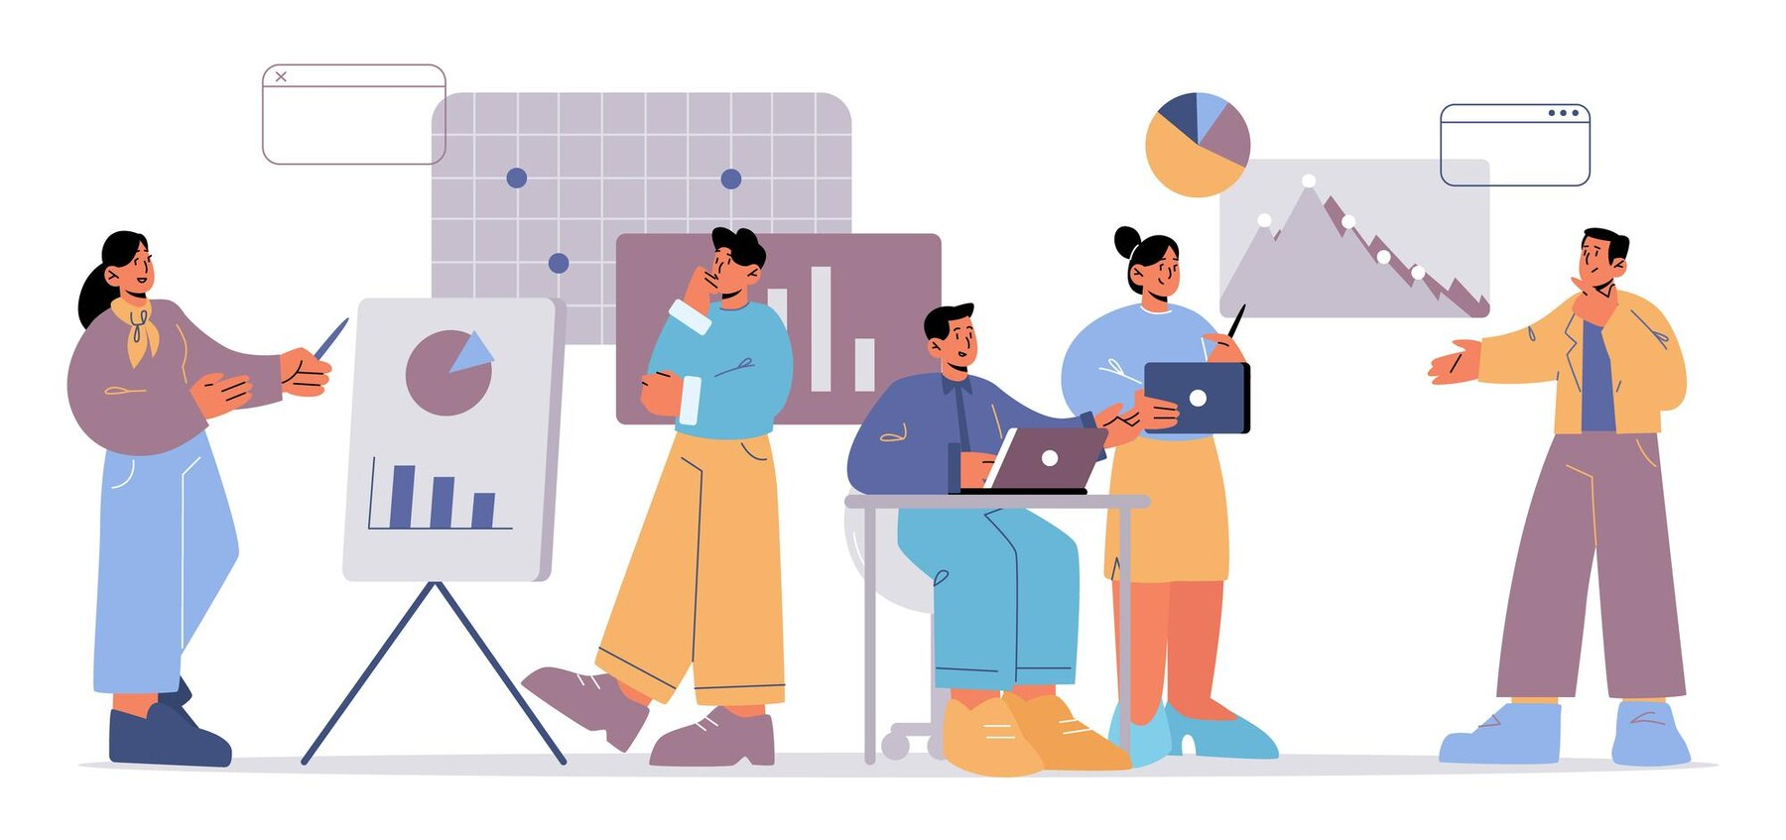
Building a Data Team
Hire technical and strategic talent
Invest in the right tools & tech
Culture of collaboration b/w data experts and fundraisers
Ongoing training & research
Understand both the technical side of data and the strategic goals of fundraising
CRM systems, databases, data visualization platforms
Ensure data experts and fundraisers work together seamlessly
Skill development and upskilling, cross-disciplinary learning, adapting to new fundraising and philanthropy trends
1
2
3
4

Slide 12
Practical Tips for Non-Technical Folks
Start with Data Literacy Training
Organize workshops or online courses to help everyone understand basic data concepts.
Focus on building confidence in reading and discussing data.
Use Simple, User-Friendly Tools
Start with tools that don’t require advanced technical skills (e.g. Excel, Google Sheets) for data tracking and basic analysis.
Use free or low-cost visualization tools (e.g., Power BI, Tableau Public) for simple dashboards.
Daily Data-Driven Decisions
Encourage team members to use data in everyday decision-making.
Ask simple, data-related questions during meetings (e.g., "What does the data tell us about last month's campaign performance?").
Start Small with Pilot Projects
Choose one or two manageable projects. A good one is collecting clean data.
Focus on projects with immediate impact.

Slide 13
100%
of people that don’t ask clarifying questions regret it later.
Akshat Thakur
Data Analyst
University of British Columbia
akshat.thakur@ubc.ca
linkedin.com/in/akshatthakur

