Slide 1
Targeted Prospect Research & Prospect Management Support
Proactive Pipeline Strategies
Kat Carson, Senior Research Strategist
Dawn Cattoor, Prospect Management Coordinator
University of Calgary Development & Alumni
October 2024

Slide 2
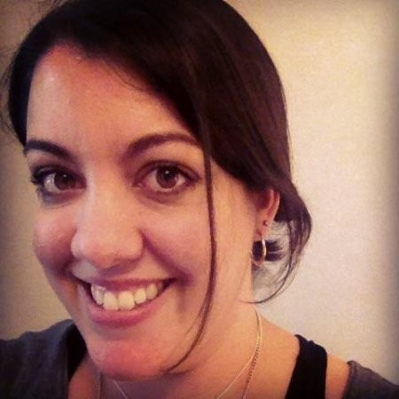
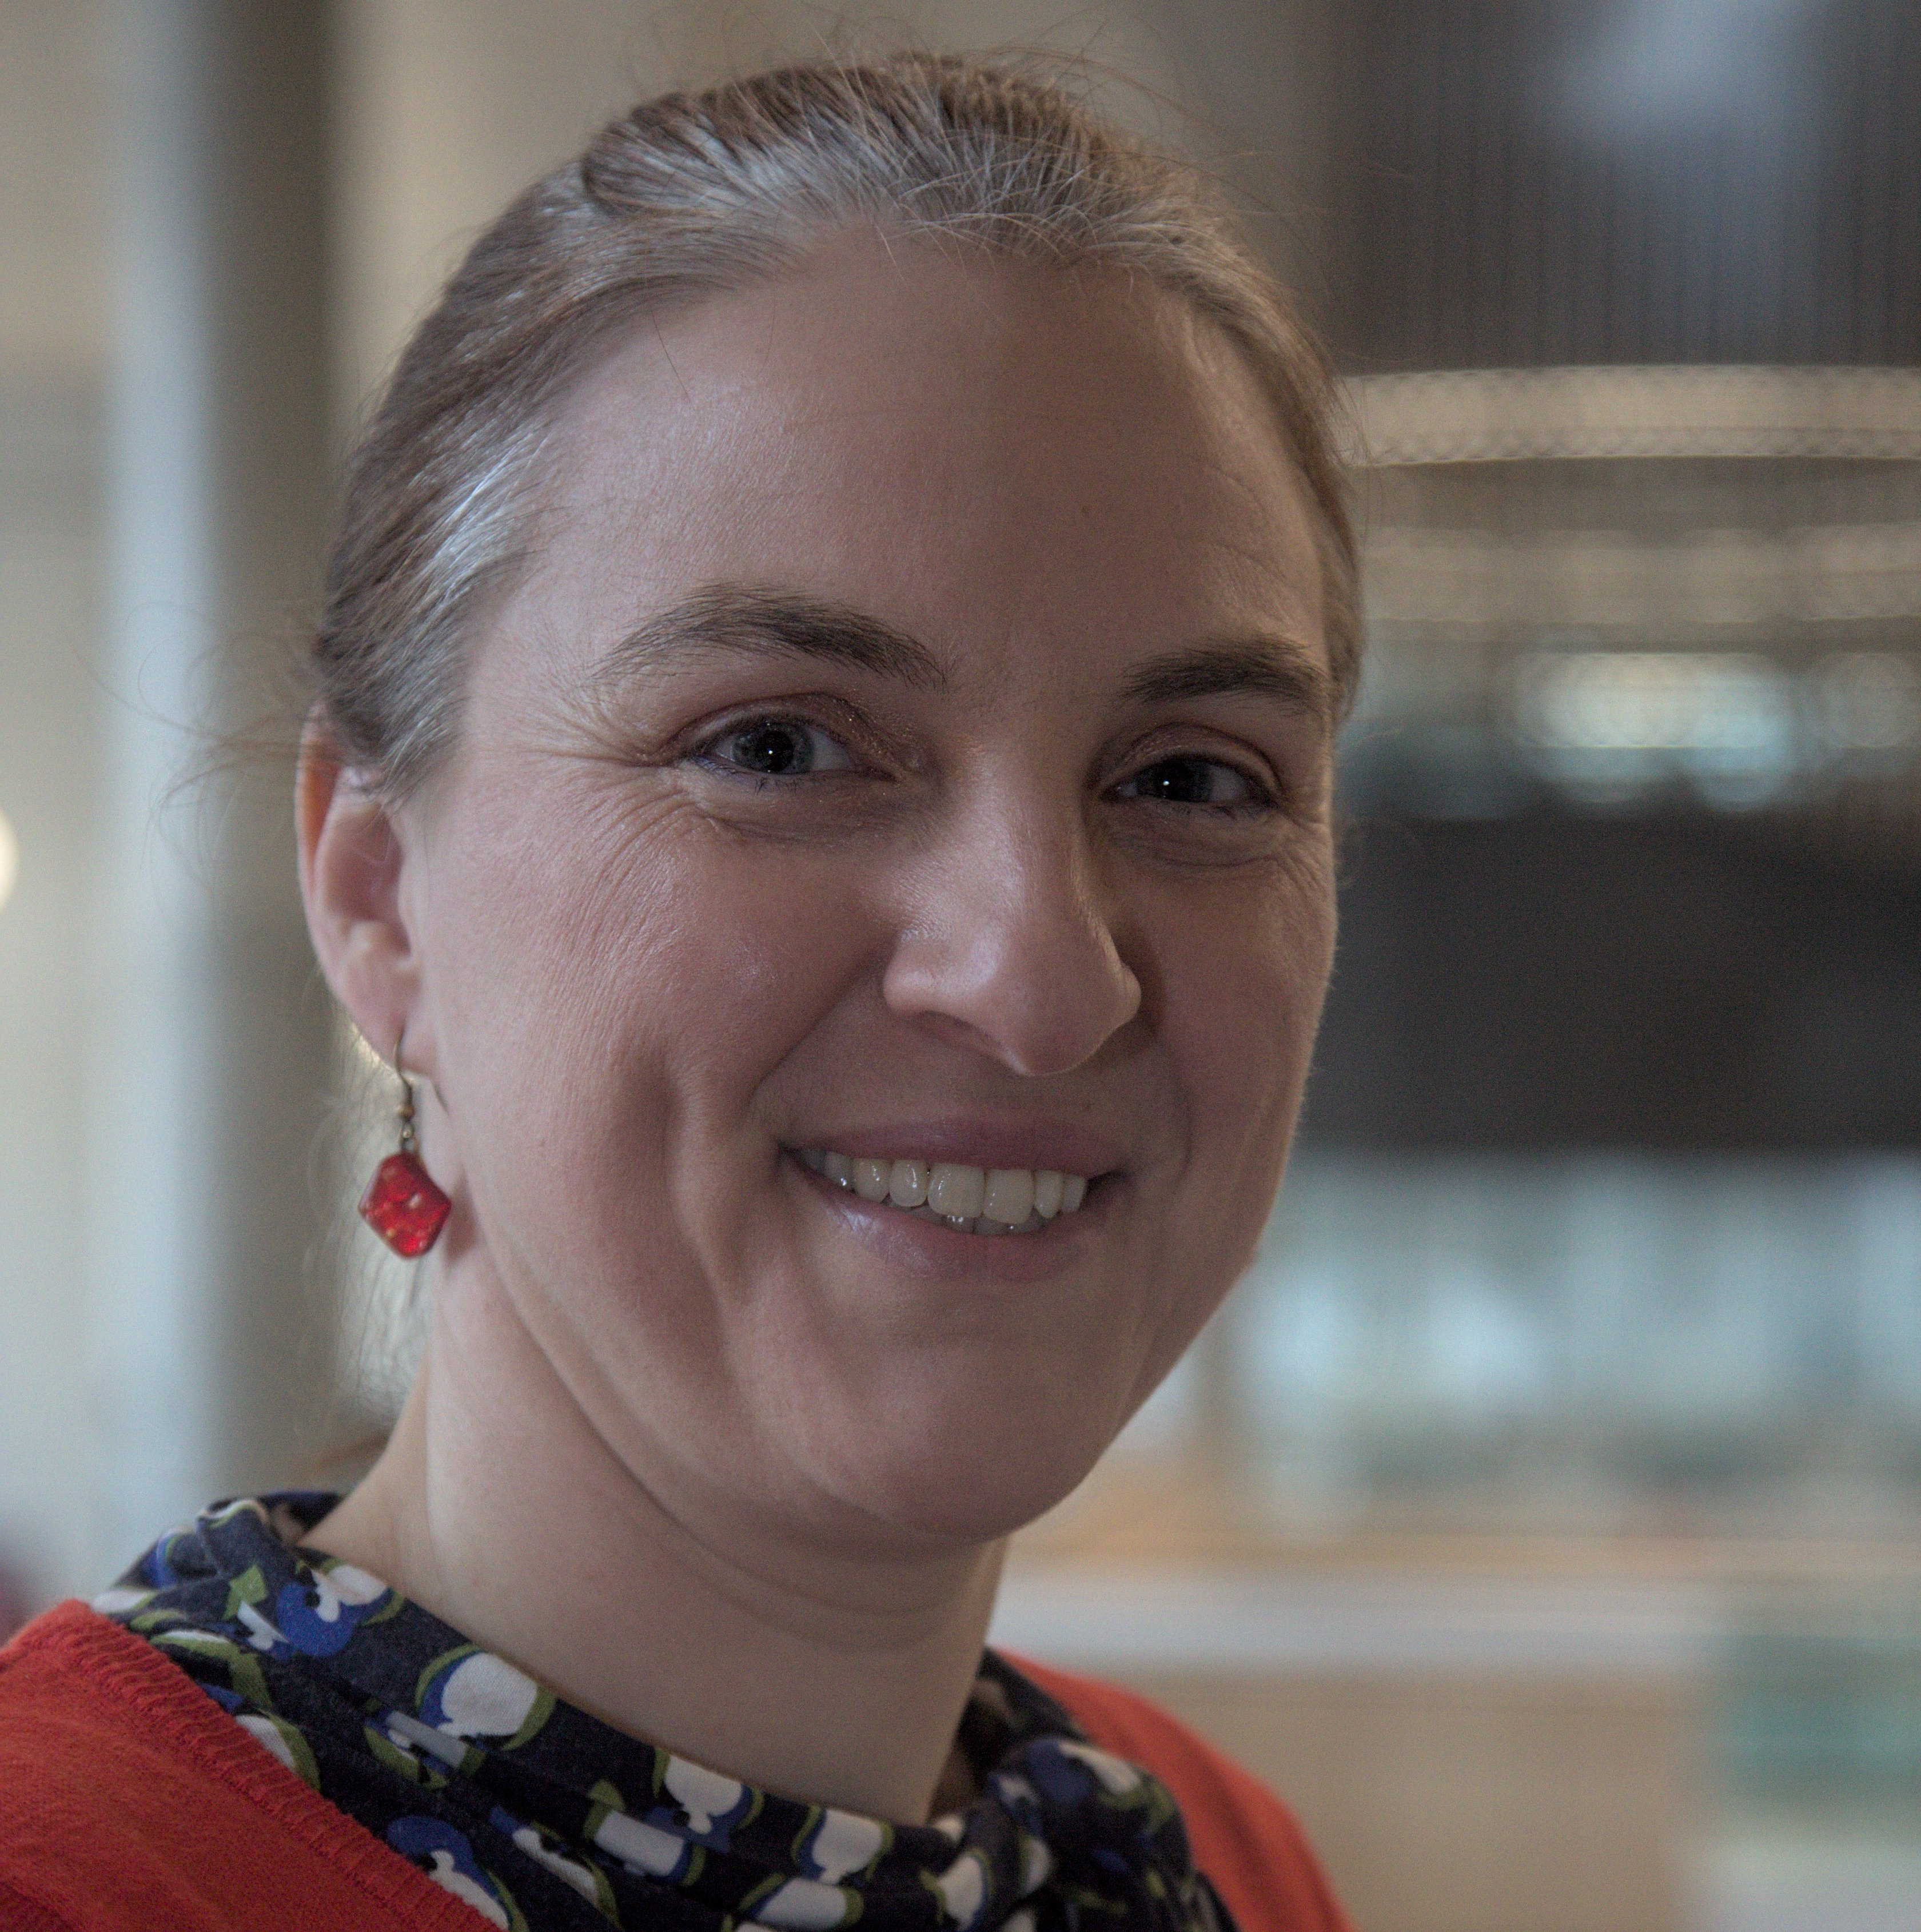
A bit about us!
15+ years in Prospect Management and Prospect Research
Has two ginger cats (Marmalade and Toast)
Loves reading, writing, crocheting, and cross stitch
Needs a good book recommendation so put some in the chat
Feel free to get in touch: kbcarson@ucalgary.ca
6 years as Prospect Management Coordinator at UCalgary
Previously Quality Management & Strategy Consultant
Loves reading, spending time in the Rockies (hiking, skiing, camping)
Feel free to get in touch: dawn.cattoor@ucalgary.ca

Slide 3
Agenda
Raison d’être
Support
The $64,000 Question
Example 1: Pipeline Optimization (or Scrub)
Or, How Prospect Research & Prospect Management (PRPM) proactively supports a strong pipeline, and efficient & strategic fundraising
Example 2: Pipeline Health Check
Or, How PRPM proactively supports fundraiser work
Considerations & Conclusions (so far…)
Q&A

Slide 4
Raison d’être
Revenue development by providing support to frontline fundraising team
UCalgary in numbers
Annual Fundraising Goal of $120M
42 frontline fundraisers
50 development services staff (incl. stewardship team, data team, gift processing, PRPM)
PRPM team: 10

Slide 5
University of Calgary: PRPM
PRPM Team:
Director
Prospect Research: 5 staff
1 manager
3 senior research strategists
1 analyst
Prospect Management: 4 staff
1 manager
3 prospect management coordinators
UCalgary is hybrid (centralized and decentralized frontline teams); PRPM team members are assigned to different faculties/units as liaisons

Slide 6
Support
Generally, PRPM support falls into one of two categories:
Reactive | Proactive
Frontline → PRPM → Frontline | PRPM → Frontline

Slide 7
The $64,000* Question… *Not adjusted for inflation
How Can We Be More Proactive in our Work?

Slide 8
Example 1:
Pipeline Optimization

Slide 9
Pipeline Optimization – What is it?
Proactively supporting a strong pipeline to drive efficient & strategic fundraising
Full review of ALL prospects in a fundraiser’s portfolio
Reduce the portfolio down to only the BEST prospects
High capacity (relative to the fundraiser’s position – ideal capacity for principal gift prospect vs. annual gift prospect is going to look differently)
High affinity for the organization, and high levels of engagement with the organization
Highly interested in supporting the organization

Slide 10
Pipeline Optimization – Process
PM:
Analyze data, highlight gaps, Add recommendations
PM & PR:
Review, discuss gaps and info needed – and why
PR:
Add/update ALI & financial capacity info; Add insights
PM & PR:
Prep for meeting
PM, PR, and Frontline team:
Meet to review prospects
CRM database: financial capacity ratings, ALI rankings, prospect strategies
PM:
Generate pipeline optimization report

Slide 11
Pipeline Optimization – Results

Slide 12
Pipeline Optimization – Results
High capacity & low affinity: Keep & cultivate | High capacity & high affinity: Keep & solicit
Low capacity & Low affinity: Release | Low capacity & high affinity: Redirect from/to SDOD/ DOD/ ADOD / Advisor/ Annual Giving
Capacity
Affinity

Slide 13
Pipeline Optimization – Results

Slide 14
Pipeline Optimization – Results
Going into the Meeting | After the Meeting
PRPM is prepared for the discussion and questions from the frontline team. PRPM is aligned. | Scrubbed pipeline with a better sense of who has what capacity and affinity. Improved prospect strategies for the remaining prospects. Prospects are reassigned if need be.

Slide 15
Example 2:
Pipeline Health Check

Slide 16
Pipeline Health Check – What is it?

Slide 17
Pipeline Health Check – Process
PM:
Generate health check report
PM:
Analyze data, add summary & recommendations
PM & PR:
Review, discuss gaps and info needed – and why

Slide 18
Pipeline Health Check – Process
Data shows | Target at risk | PM looking for | Research recommendations
Low number in Qualifications | Qualifications We are not renewing the donor pool | Discuss options to find more prospects to qualify, methods to qualify | Prospecting – add some names
Prospects stalling | Solicitations, Gifts Closed | Ask why they are stalling. Projects not ready, need leadership support, ideas for connecting, etc. Do we switch them out for other prospects? | Look at the Cultivation pool – who is ready to move forward (look at ask dates), who has finished their pledge?
Penetration rate is too low | Significant interactions Not engaging everyone on your pipeline, stagnant pipeline | Encourage to work in breadth as well as depth. Determine who we aren’t talking to – and why are they not engaging (see above), or are they behind on entering contact reports? | High-level analysis of ALI – have interests/alignments changed? Are there any connectors we can leverage?
Pipeline size is too small / big | Not enough prospects to meet your goal, versus being overwhelmed and lacking focus. | How to get back to the recommended pipeline size? More prospecting needed, different prospects? Or do we need a pipeline scrub? | Prospecting – add some names Filling in the gaps for a pipeline scrub State the case for releasing prospects
Pipeline balance is off | One of QU or SO, depending how the balance is skewing | Why/where off balance? Can we help with prospect strategies, connect to other FLF, etc.?
$$ Forecast is too low | $$ target. | Do they have the right level prospects to reach their target? / Are they asking at the right dollar amount? | Update capacity Prospecting for higher-capacity names

Slide 19
Pipeline Health Check – Process
PM:
Generate health check report
High level action plan for the pipeline
PM:
Analyze data, add summary & recommendations
PM & PR:
Review, discuss gaps and info needed – and why
PM, PR, Fundraiser: Review at bimonthly meeting

Slide 20
Pipeline Health Check – Results
Going into the Discussion | After the Discussion
PRPM is aligned on desired outcomes for the pipeline PRPM has specific recommendations to discuss with frontline fundraiser, including the meeting topic for the next prospect development meeting with the fundraiser | Everyone (PRPM and fundraisers) has a high-level view of the work that needs to be done Relationship building – we are invested in the fundraiser’s success

Slide 21
Considerations & Conclusion
Culture – is the PRPM team viewed as a trusted advisor?
Communication - LOTS of conversations within the PRPM team, as well as with fundraisers
Resources & workload – consider an incremental approach

Slide 22
Incremental Approach – Solving for Scalability
Data shows | Target at risk | Different degrees of proactive work made by the PRPM team to mitigate the risk:
 |  | Smaller shop/service | Larger shop/trusted advisor
Low number in Qualification | Qualification Solicitation Funds raised | Prospecting – add some names. “I recommend I do a prospect list for you.” | Prospecting – add specific names for specific priorities “I’ve started developing a prospect list for you – here are some of the names, and possible alignments with priorities – do you know any of these folks?”
Prospects stalling in Cultivation | Solicitation | Look at the Cultivation pool – high-level analysis | Deep dive into the Cultivation pool – the “Rights”

Slide 23
Back to Considerations & Conclusion
Prospect Development can be proactive by:
leveraging our high-level viewpoint, our relationships across teams, our affinity for data, the tools and reports
to make data-driven recommendations
to close the gaps that exist in the pipelines,
and/or to keep the focus on the best prospects,
and to be a trusted advisor for the fundraisers

Slide 24
Questions?

Slide 25
Thank you!

