Slide 1

Dynamic Data Through Dynamic Ratings:
Sunnybrook Foundation’s New Approach
David Duncan & Leslie Johnson
October 22, 2024

Slide 2
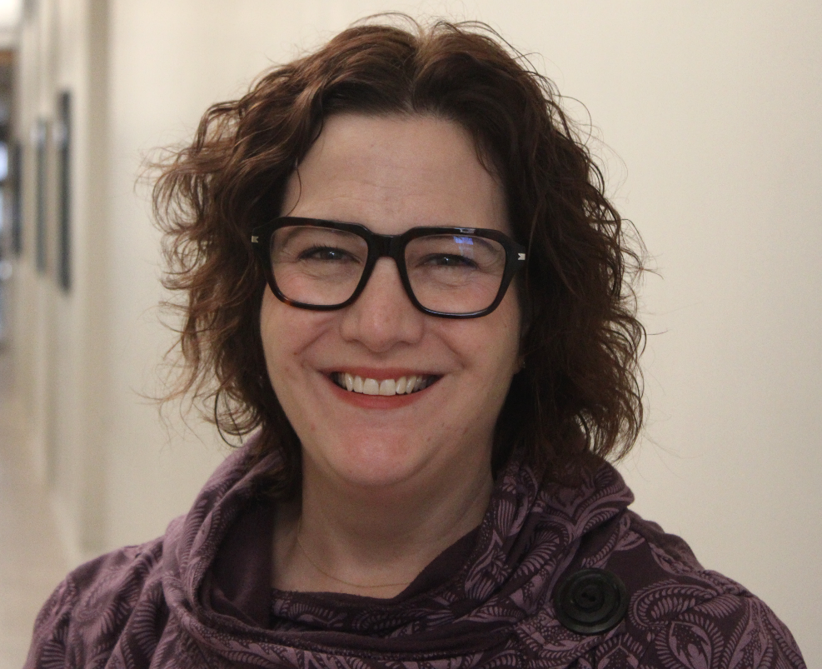
Hello there!
David Duncan
Research Officer
david.duncan@sunnybrook.ca
Leslie Johnson
Research Officer
leslie.johnson@sunnybrook.ca

Slide 3
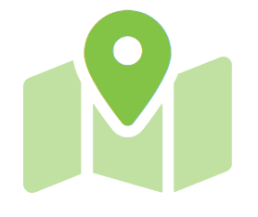
Agenda
Objectives & Key Learnings
Then & Now: Prospect Research at Sunnybrook
Overview of LIA
Development Process & Implementation
Impact
Review & Questions

Slide 4
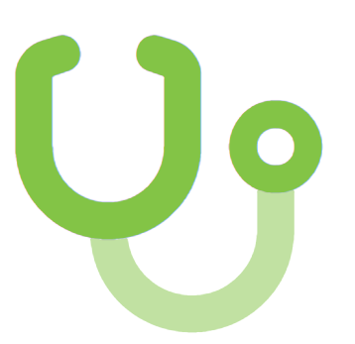
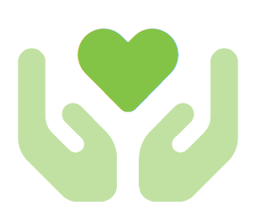
Sunnybrook Health Sciences Centre & Sunnybrook Foundation
Sunnybrook Health Sciences Centre is one of Canada’s top-rated hospitals and research centres that provides 1.3 million patients with care annually
Sunnybrook Foundation exists to raise funds in support of research, education and equipment initiatives at Sunnybrook Health Sciences Centre
  Raised $72M in FY23/24 from 54,000 donors
  1.6M+ constituent records
  Research team supports 15 Major Gift frontline fundraisers

Slide 5
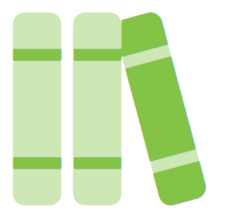
Key Learnings
  Understand Sunnybrook’s collaborative and affordable approach to creating a new ratings system
  Differentiate between “typical” rating systems and this new dynamic system which uses internal and proprietary data
  Learn how the new system was implemented and the many ways it is being used
  Come away with real examples of how LIA has helped in surfacing prospects

Slide 6
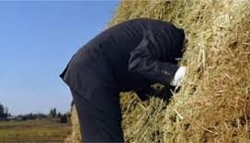
Once Upon a Time at Sunnybrook Foundation….
High value donors were hiding in plain sight among donor pool for all portfolios
Prospect ID was static & manual, heavily reliant on Research team
Challenge for fundraisers to identify which prospects to prioritize within their portfolios

Slide 7

What If…

Slide 8
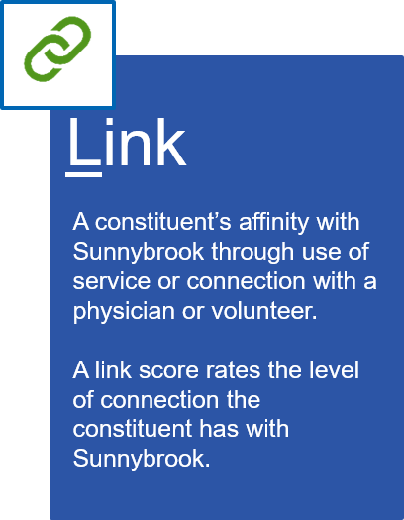
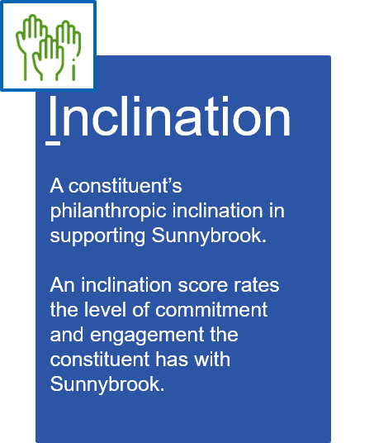
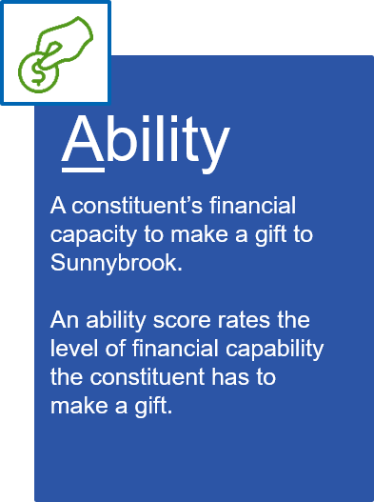
Enter L-I-A

Slide 9
The Development Process: Mixing Art with Science
1. Identify and confirm data points
2. Determine weighting of each data point
3. Build the LIA scoring algorithm
  Four discovery workshops to identify data points the working group felt meaningful and relevant
  Deep-dive data analysis to validate and confirm data points brought forward by the working group
  Two workshops to assign weighting to each data point based on the working group’s observations and experience
  Weighting of each data point is quantified by data analysis
  Develop scoring algorithm based on data criteria and weighting supported by both business and data observations
  User testing, validating, revision, and roll-out

Slide 10
Data Points
Demographic Data Points
Age band
Household wealth and income
Gifts to other organizations
Sunnybrook catchment areas
SBF Touch Point Data Points
Actions
Connection to physicians
Connection to volunteers
Events
Gifts
Patient history
Proposals
Research highlights and ratings
Volunteer membership

Slide 11
Impact on Research:
“Many donors would never be researched by the Research Team as their last donation would not appear on the criteria for names to research on our Daily Prospecting Report. Some strong prospects identified by the LIA Scores have been monthly donors who have the capacity to donate at the Major Gift level. The Research Team uncovered a name whose largest donation to Sunnybrook was $1,500 who we qualified with the capacity to donate $20 million+!”
- Manager, Research

Slide 12
Impact on Research:
In less than six months, the Research team has brought forward 150+ prospects who may not have been found using typical screening methods!
The Research team now has a quick and proven method of identifying promising Community Giving prospects, specifically monthly and mid-level donors

Slide 13
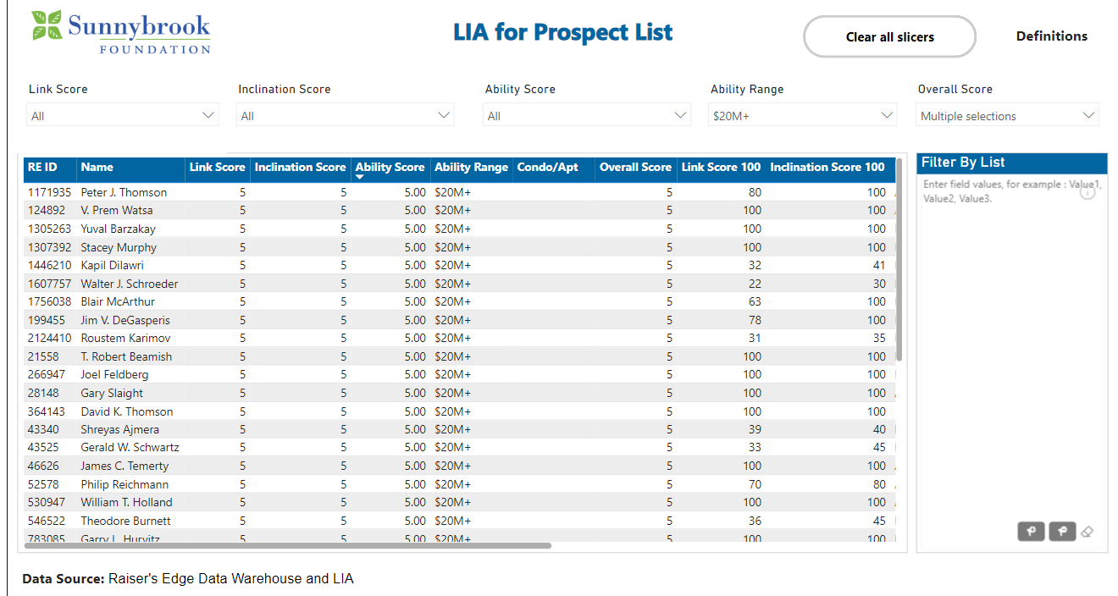

Slide 14
Impact on Major Gifts:
“All individual constituents have dynamic scores attributed to them for the first time. This empowers front-line fundraisers to efficiently prioritize their pipeline and donor engagement efforts towards prospects with the highest potential and capacity.
L-I-A also serves as a powerful tool for facilitating prospect review and discussion with our hospital partners and volunteers, allowing us to maximize our limited time with them by focusing on top potential prospects and aligning fundraising strategies with hospital needs.”
- Executive Director, Philanthropy

Slide 15
Impact on Stewardship & Marketing:
“Knowing more about our Sunnybrook donors helps stewardship align programs and resources to steward our donors and ultimately help renew their support of Sunnybrook. The LIA scores are particularly helpful for the segmentation of donors and testing the impact of additional stewardship activities on donor renewal. Not only the LIA scores, but the innovative interactive LIA map will help identify pockets of donors that may influence our decisions on thank you advertising or donor recognition.”
- Executive Director, Donor Communications, Impact and Accountability

Slide 16
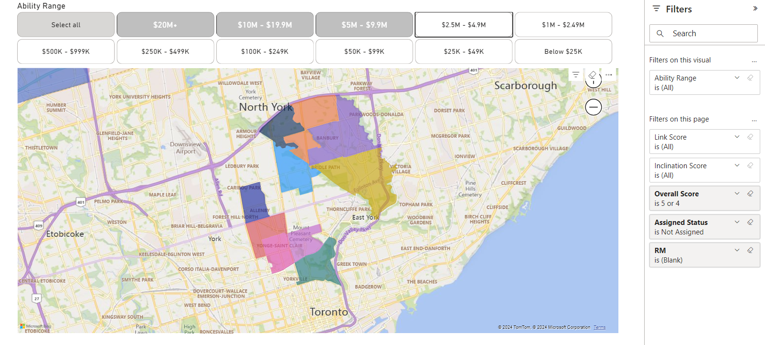

Slide 17
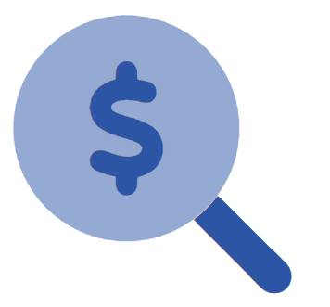
The Results
Increased self-sufficiency in prospect identification
Increased collaboration among departments
Common definitions of a “strong” prospect & increased staff data literacy
Research is focused on providing in-depth research on prospects when analysis is needed beyond LIA

Slide 18
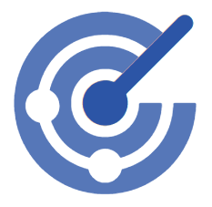
Key Takeaways
Dynamic, tailored & affordable tool which has changed prospect identification and segmentation at Sunnybrook as a whole
New prospects are backed by data
Interactions with donors entered into the database influences L-I-A score
Challenges status quo & research assumptions
Ability to decide which donors should require manual work by Research team

Slide 19
Thank you!
Questions?

Slide 20


