Slide 1
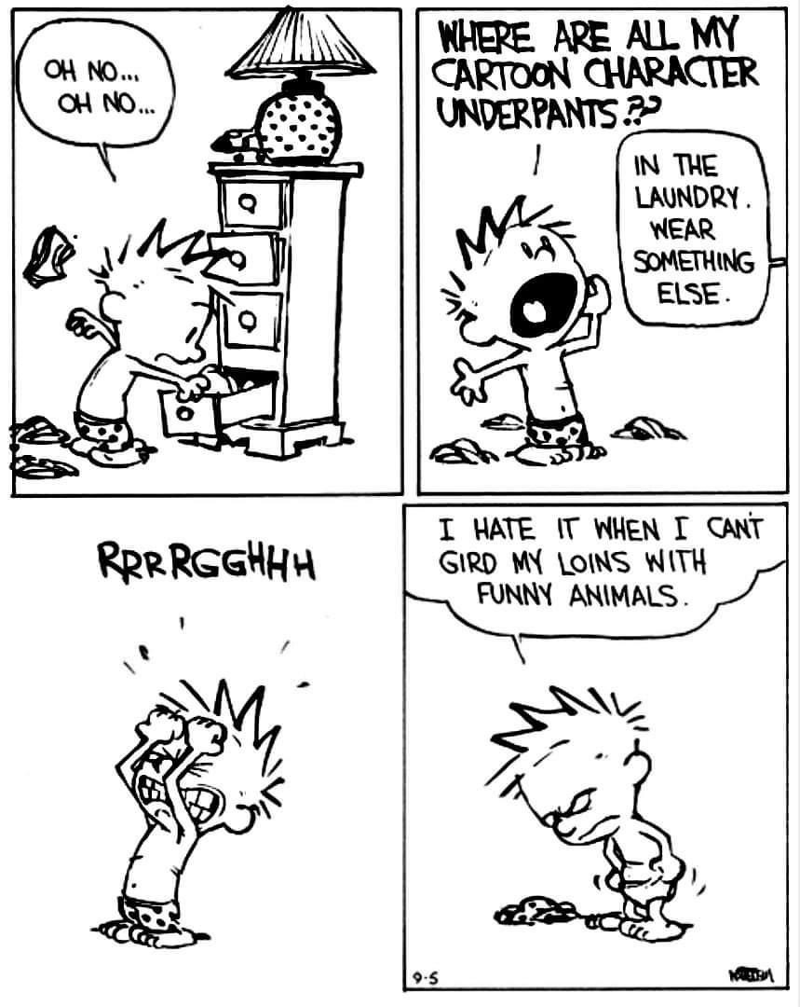
No Pivoting Required:
Finding Balance, Joy and Clarity after COVID
APRA Canada Conference
Joanne Linka
The Cridge Centre for the Family
Victoria, BC

Slide 2
Work your purpose?!?

Slide 3
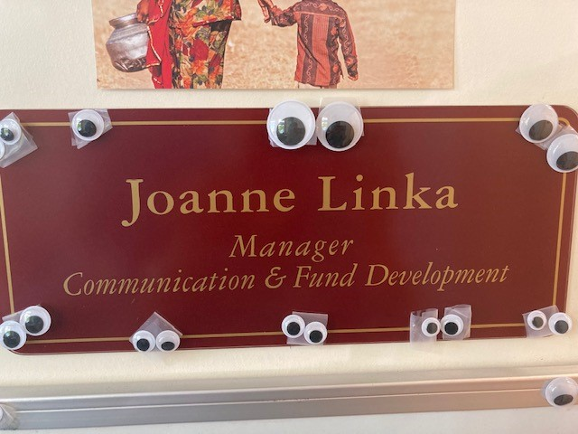

Slide 4
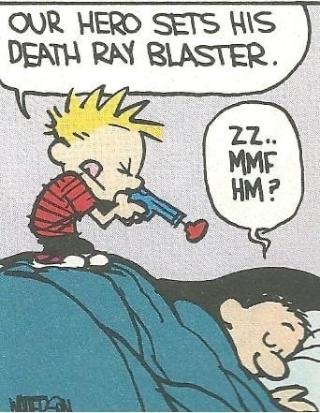
Responsibilities:
donor stewardship
donor records management
professional writing
social media
website management
graphic design
public speaking
advertising & marketing
media relations
business solicitations
grant writing
donation tracking
event planning
networking
advocacy
strategic planning
BURN OUT!

Slide 5
Don’t pivot until you puke

Slide 6
Share the Load
Three specialists rather than one generalist

Slide 7
Quarterly Review
Personal Manifesto
Responsibilities
Goals & Plans

Slide 8
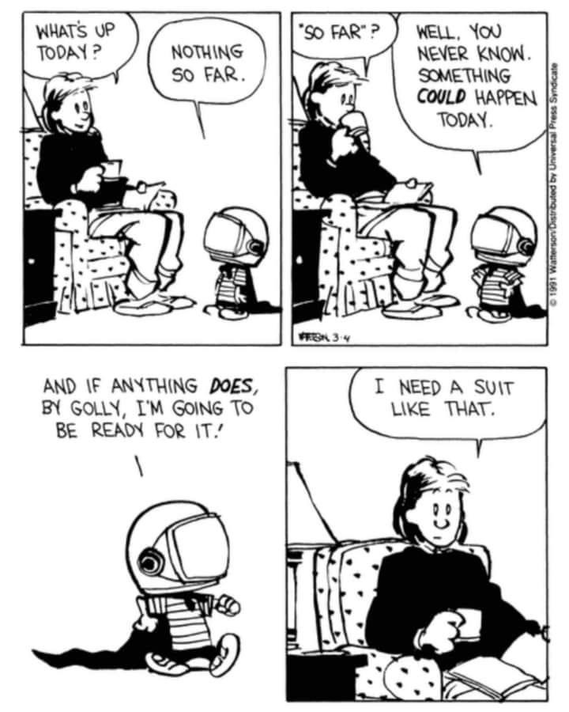
To-Do Spreadsheet

Slide 9
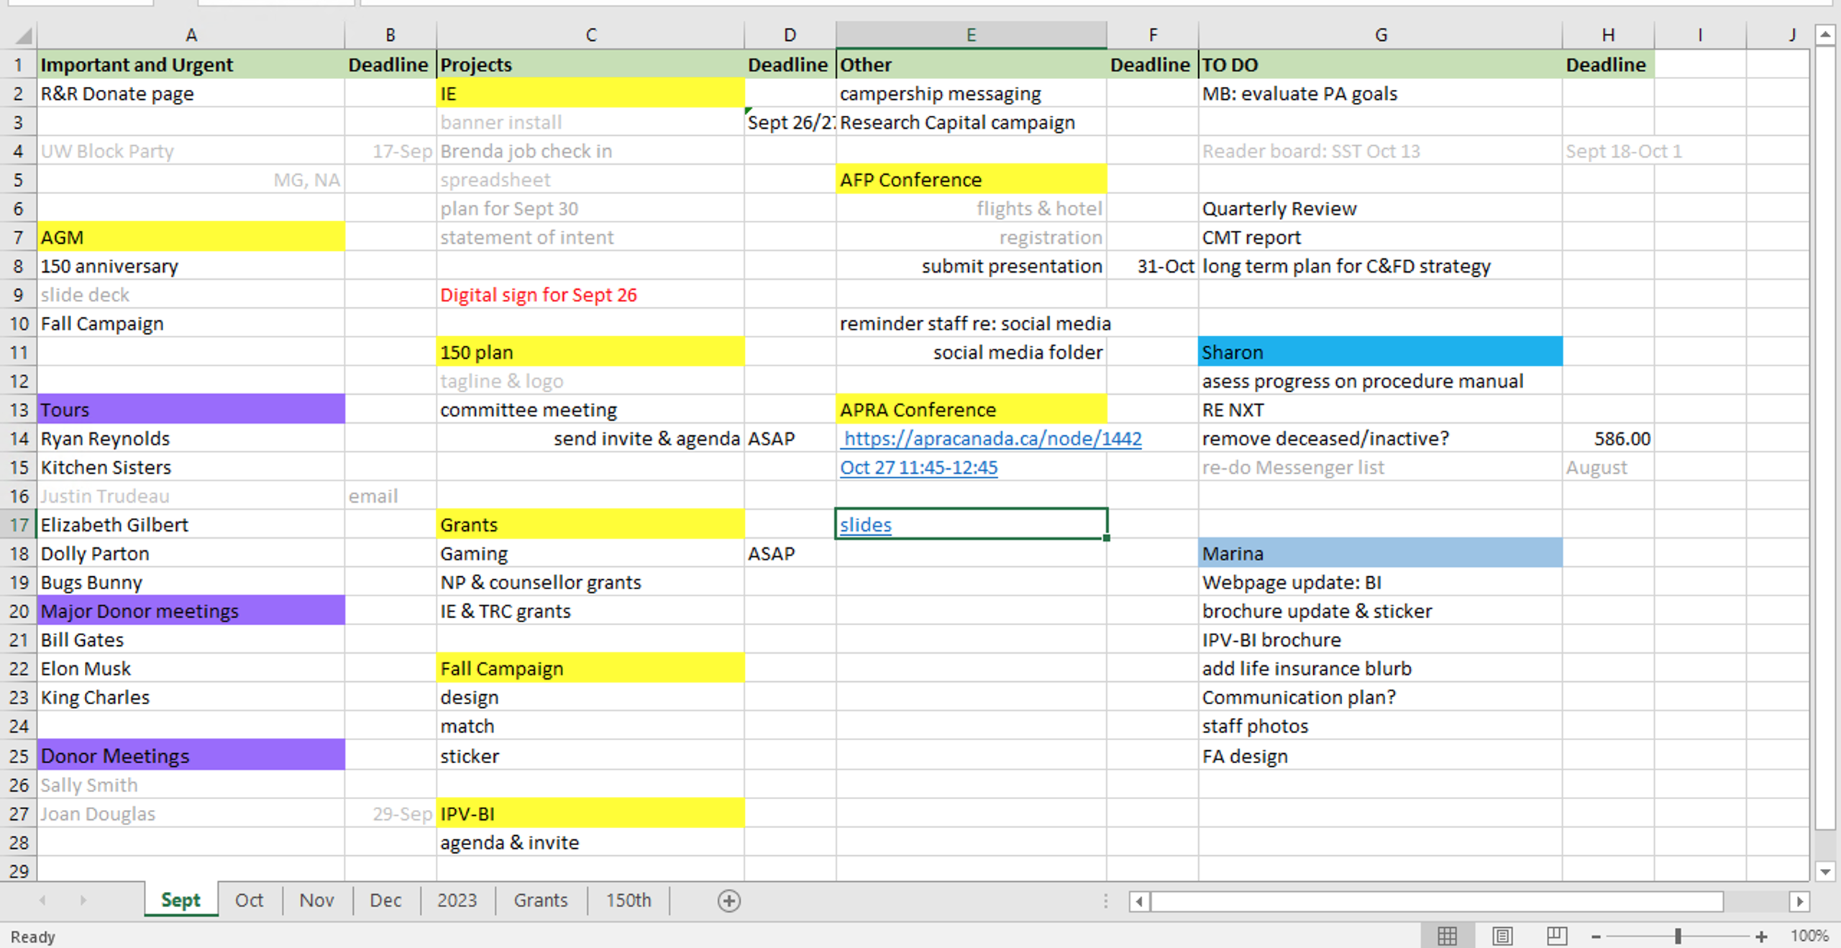

Slide 10
3 Tools
Share the Load
Quarterly Review
To-Do Spreadsheet

Slide 11
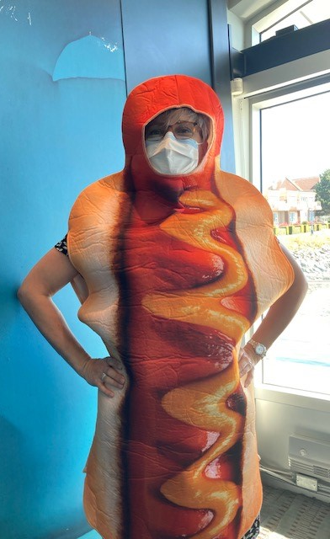
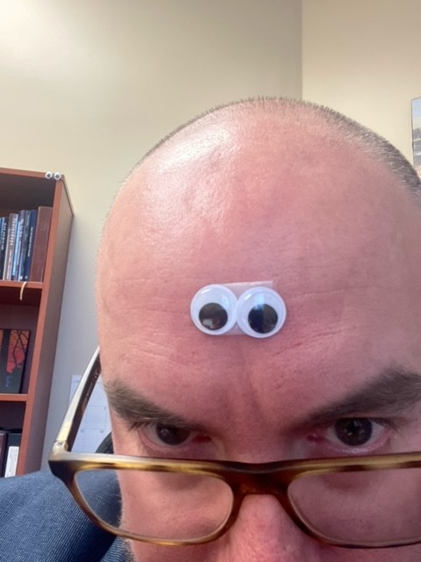
Laughter….

Slide 12
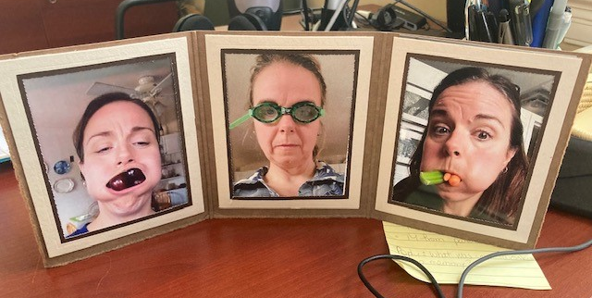

Slide 13
Anything is possible!
Be Excellent in Everything!

Slide 15
Listen to your body

Slide 16
Thank you!
And thanks to Calvin & Hobbes for laughter amidst the ridiculousness.
jlinka@cridge.org

